Slide 1

Data Visualization with
Shirin Shirazi
University of California, Riverside
Summer 202

Slide 2


Slide 3
Exploratory vs Explanatory
Searching for insights
Don't need to be perfect
Find the answer to your questions
Worksheets and Dashboards
Providing your results for others
Necessary emphasis to convey your message
Accurate, insightful, and visually appealing
Stories and Dashboards

Slide 4
Why Data visualization?
Communicate information about data
Deliver the right insights
Engaging
Informative
Summary statistics do not give enough information about the distribution

Slide 5
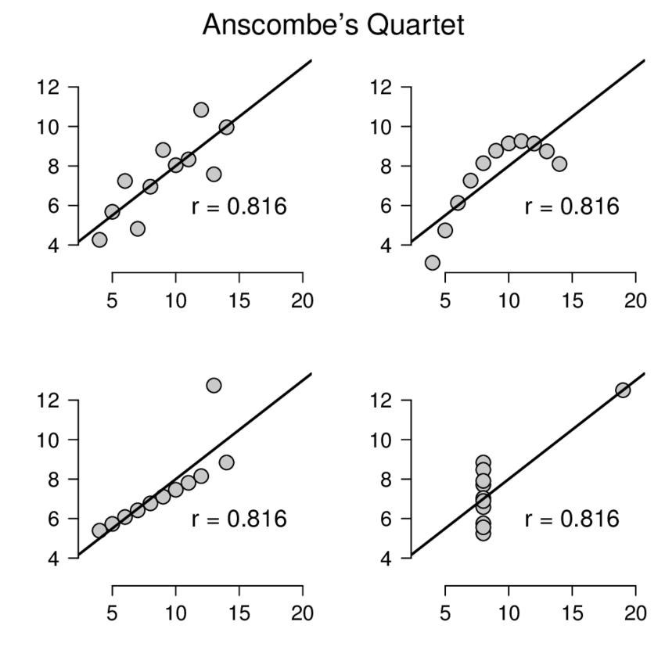
Anscombe’s Quartet
X | Y | X | Y | X | Y | X | Y
10 | 8.04 | 10 | 9.14 | 10 | 7.46 | 8 | 6.58
8 | 6.95 | 8 | 8.14 | 8 | 6.77 | 8 | 5.76
13 | 7.58 | 13 | 8.74 | 13 | 12.74 | 8 | 7.71
9 | 8.81 | 9 | 8.77 | 9 | 7.11 | 8 | 8.84
11 | 8.33 | 11 | 9.26 | 11 | 7.81 | 8 | 8.47
14 | 9.96 | 14 | 8.1 | 14 | 8.84 | 8 | 7.04
6 | 7.24 | 6 | 6.13 | 6 | 6.08 | 8 | 5.25
4 | 4.26 | 4 | 3.1 | 4 | 5.39 | 19 | 12.5
12 | 10.84 | 12 | 9.13 | 12 | 8.15 | 8 | 5.56
7 | 4.82 | 7 | 7.26 | 7 | 6.42 | 8 | 7.91
5 | 5.68 | 5 | 4.74 | 5 | 5.73 | 8 | 6.89
The same Mean, variance, correlation, line that best fits!

Slide 6
Data Types
Quantitative
Categorical
Histogram
Normal Quantile Plot
Stem and Leaf Plot
Box and Whisker Plot
...
Bar Chart
Pie Chart
Pareto Chart
...

Slide 7
The right way to present the data, is the way that best help you answer your questions

Slide 8
Software to create visualizations
Ask and answer questions about data
Both explore and explain
Fast insights
Interactive

Slide 9








Vs.
Spreadsheet app for holding your data
Exploratory tool
Advanced calculations
Quickly see & understand data
Do analysis
Change things , iterate
Ask deep questions of your data

Slide 10






Reader
https://public.tableau.com/s/
Datasets used today
https://bit.ly/3IN4tRP

Slide 11

https://www.tableau.com/academic/digital-data-skills
Get Data Skills.

Slide 12
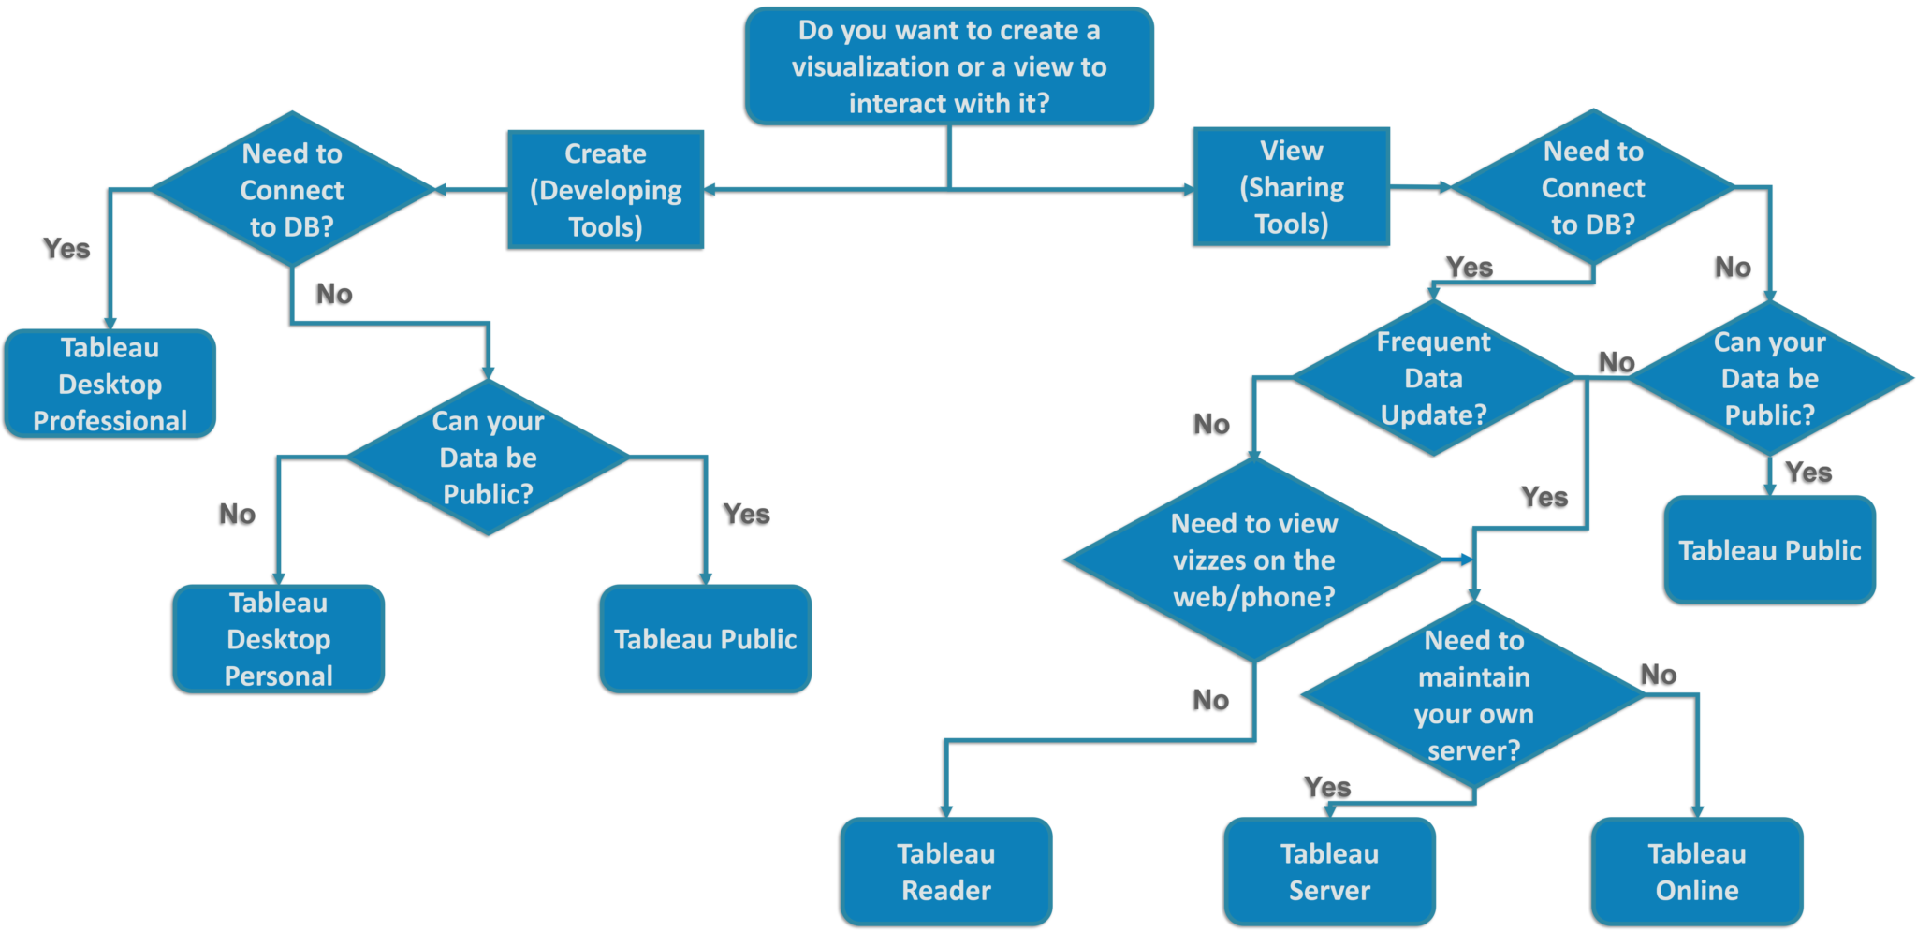
Don’t know which version to download?

Slide 13

Become familiar with Tableau, so you are not afraid to explore beyond what is discussed here!

Slide 14
Part 1: Basic Tableau
Essentials for building any visual in Tableau

Slide 15

Tableau Basics
Connecting to data
Show me
Combining data
multiples & dual axis
Worksheets
Groups and sets
Aggregations
Calculated fields
Hierarchies
Table calculation
Marks and filters
Summary

Slide 16
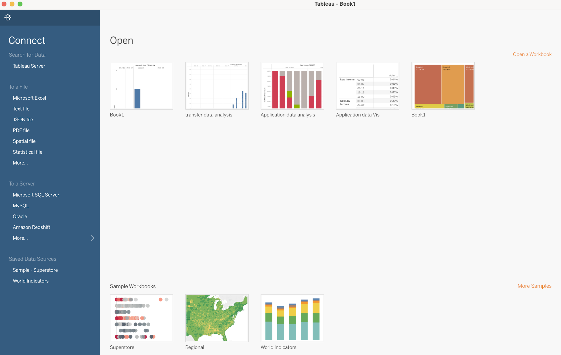
Connecting to data
Connecting different types of local/online
Different formats
Multiple data sources

Slide 17
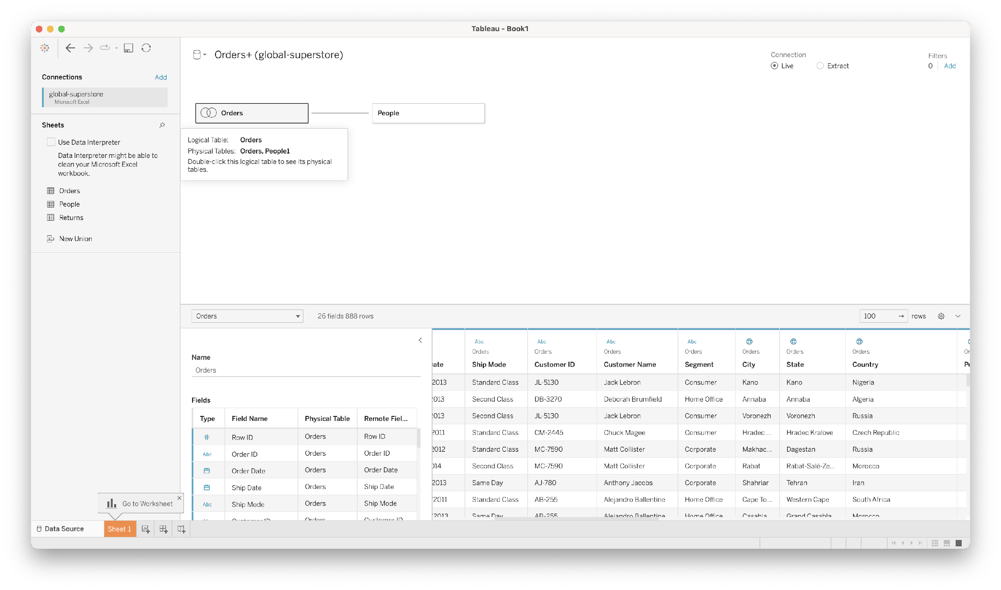
Data
Sheets treated as tables
View tables/sheets
Joining/Creating relationships
Change anything about your data
Edit name/type/count/schema

Slide 18
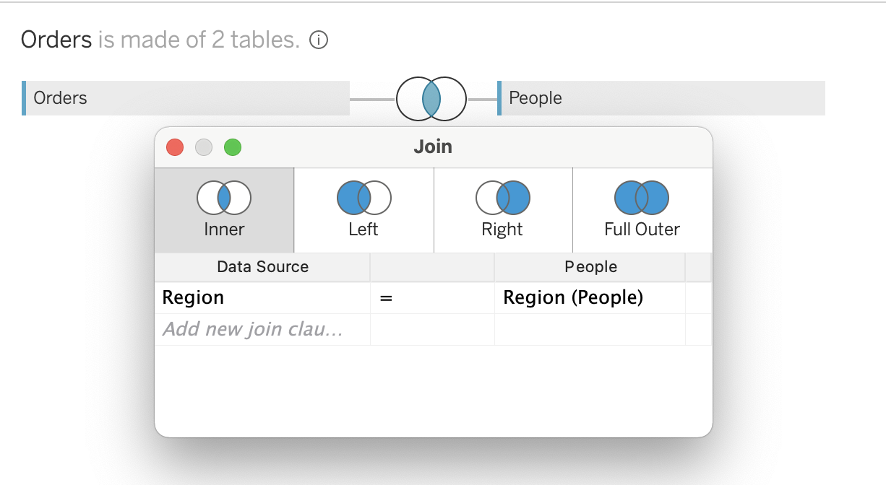
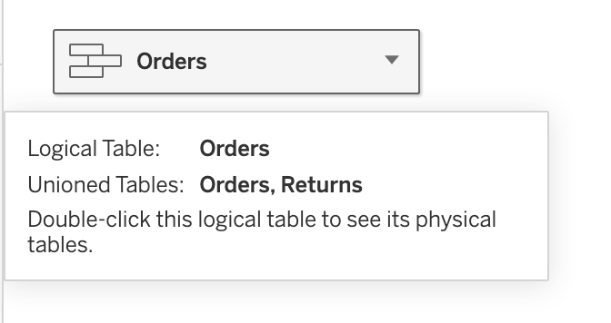
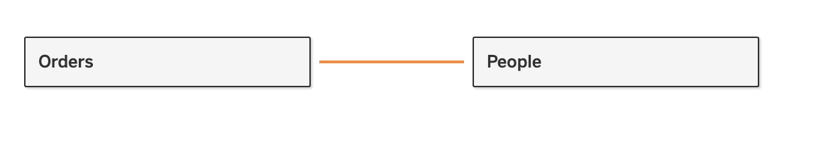
Join
Relate
Union
Typical table join based on the table schema
The tables will both be available to the worksheets
No specific change in either
Stack the data from the second table at the end of the first

Slide 19



Products
WORKSHEETS
ONE VISUALIZATION
DASHBOARDS
MULTIPLE VISUALIZATIONS
STORIES
WALKTHROUGH OF DATA

Slide 20
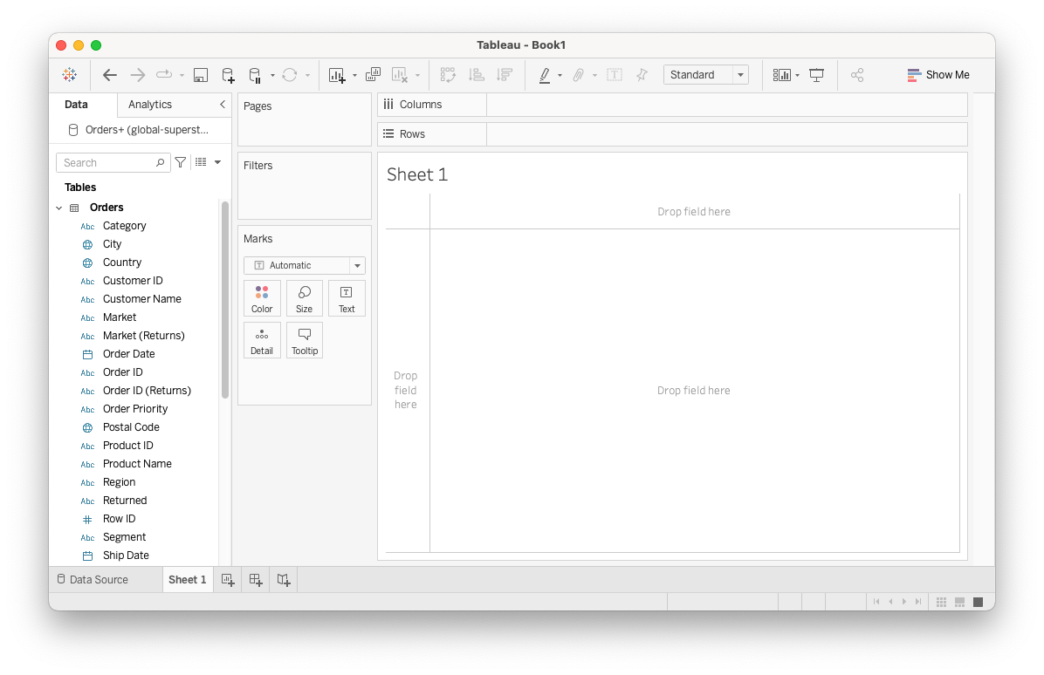
Worksheet

Slide 21
Shelves/Cards
Drag and drop fields into each shelf

Slide 22
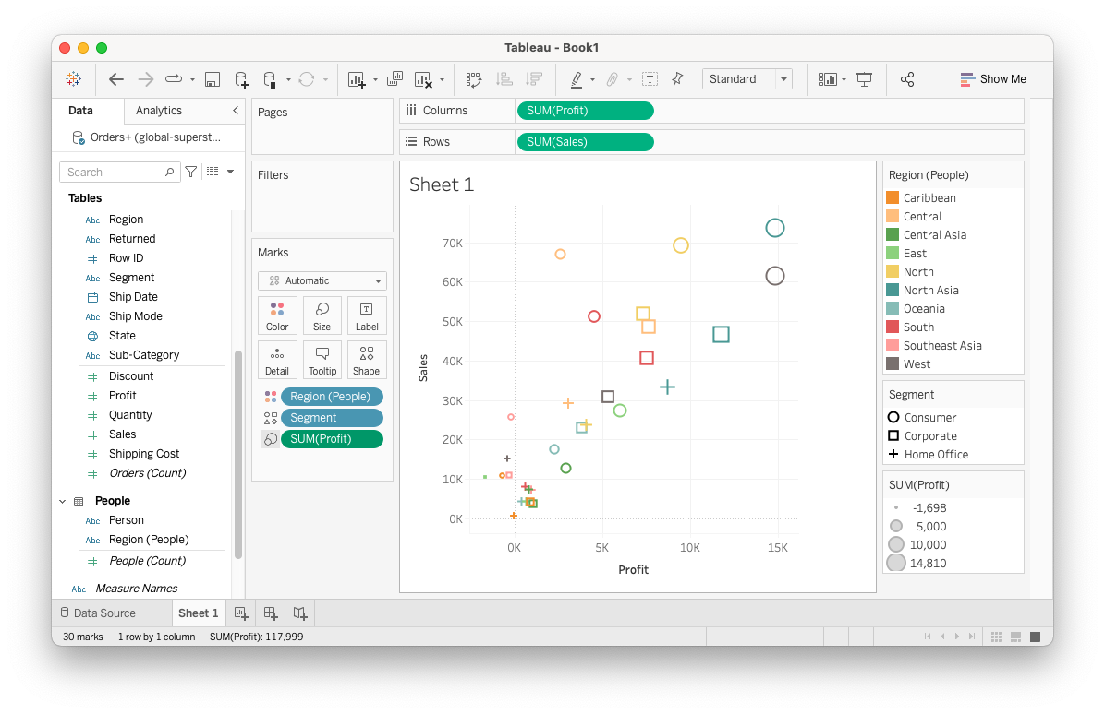
Marks

Slide 23
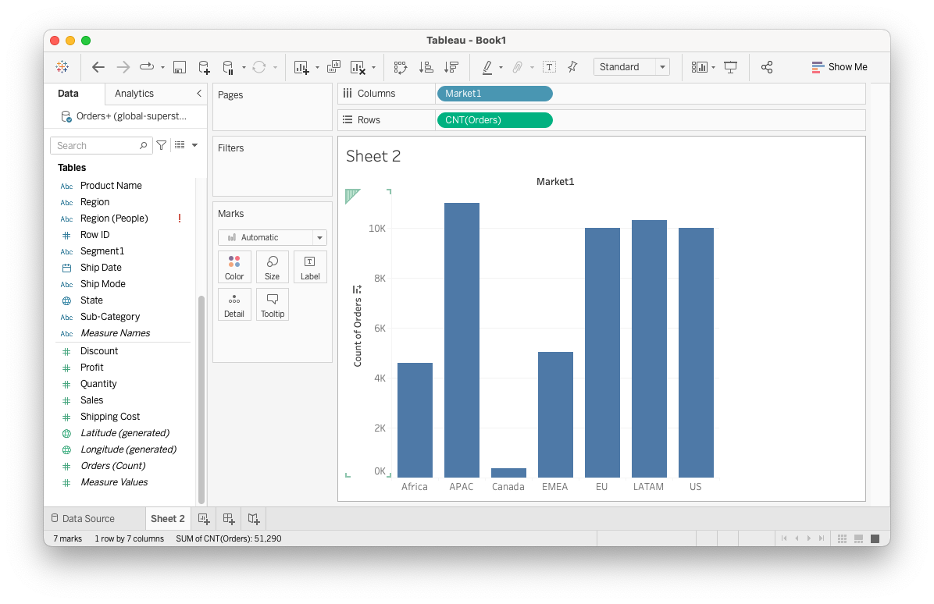
Plots

Slide 24
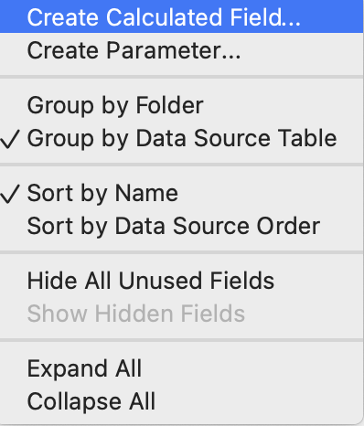
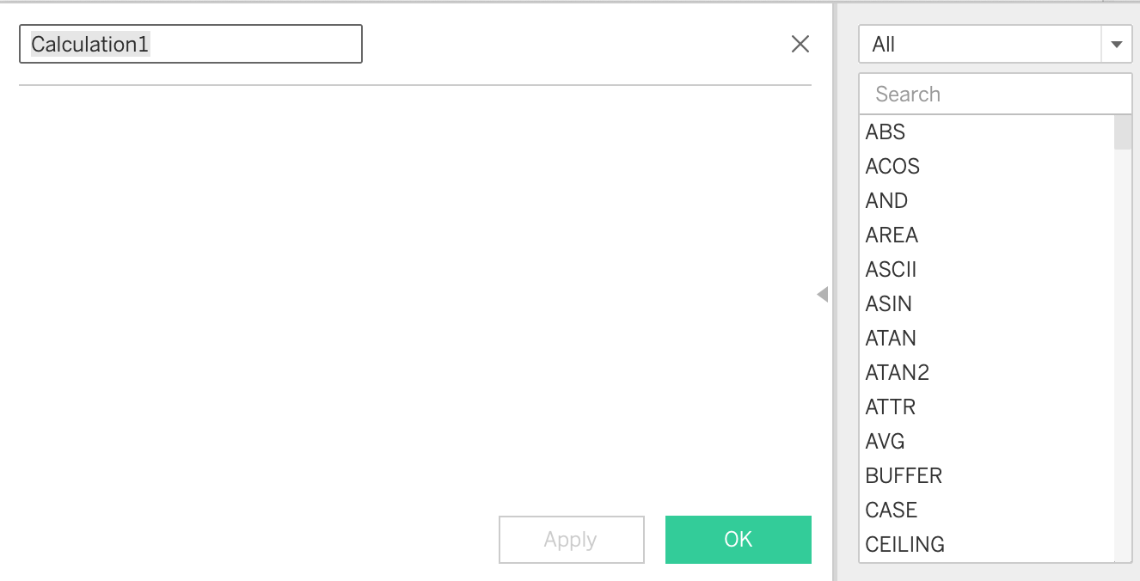
Plots

Slide 25
Analyzing Data
Asking questions from our data
Adding more markers to increase granularity
Consider Automatic aggregations
More markers to increase categories
The more Dimensions , the more detail, the more complexity
Just start exploring!

Slide 26
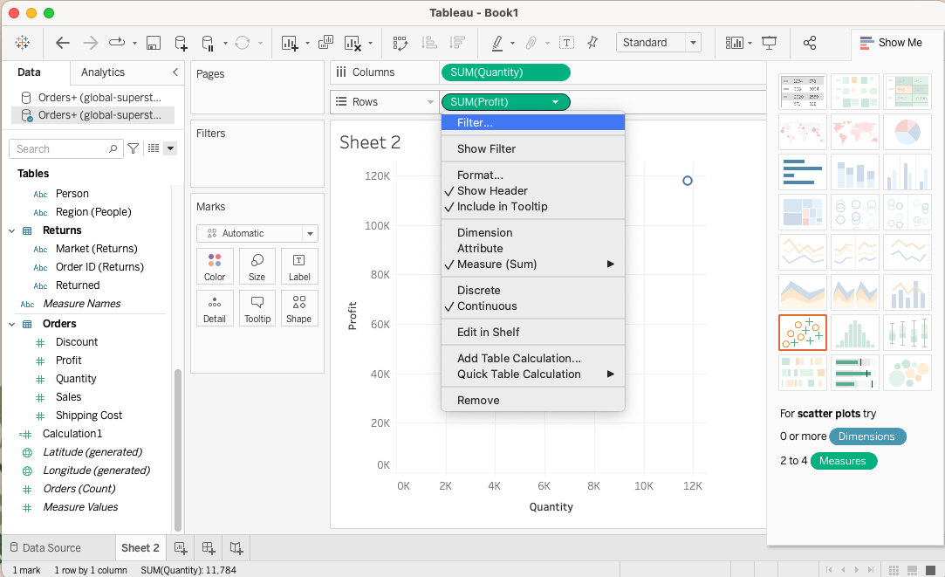
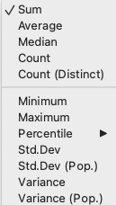
Aggregations

Slide 27


Tableau Basics
Connecting to data
Show me
Combining data
multiples & dual axis
Worksheets
Groups and sets
Aggregations
Calculated fields
Hierarchies
Table calculation
Marks and filters
Summary

Slide 28
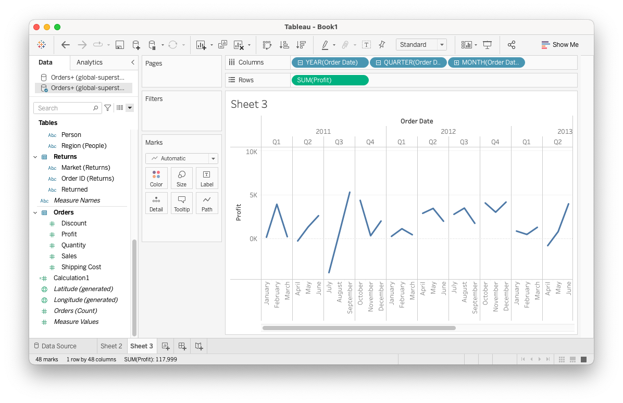
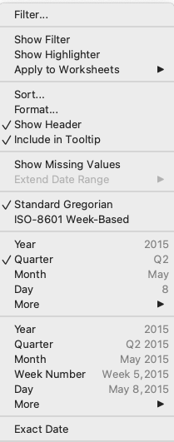
Hierarchies
Drill Down to your data!
Automatic Hierarchies for time-based data

Slide 29
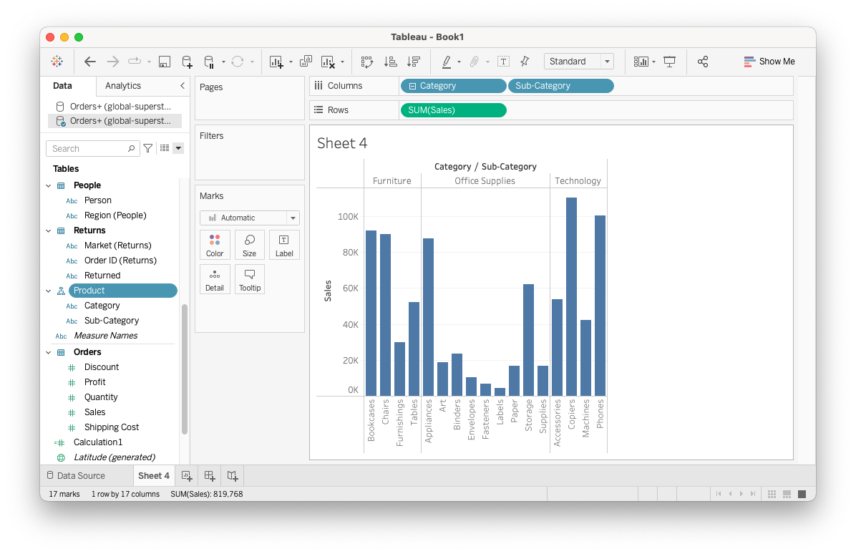
Hierarchies
Create your own
Drag sub-category

Slide 30
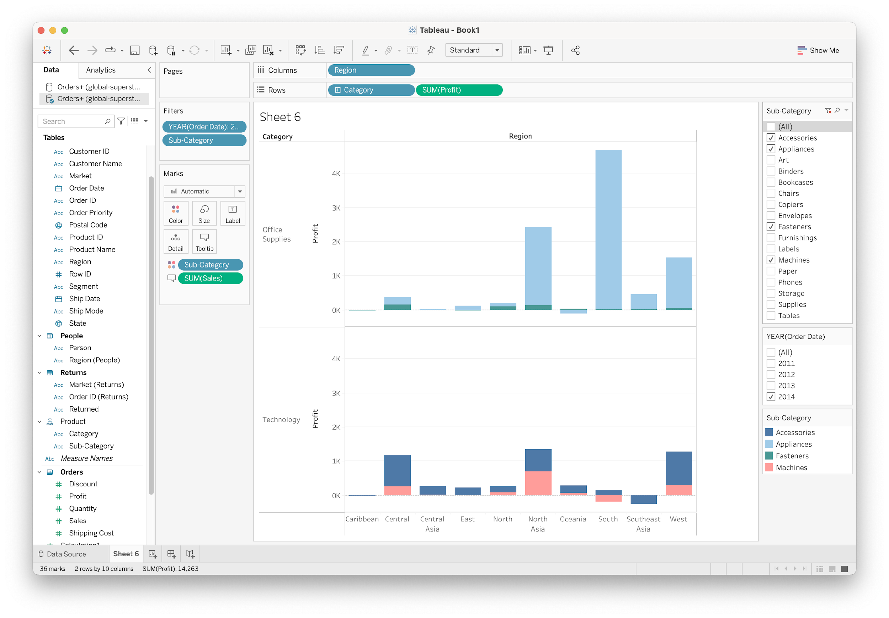
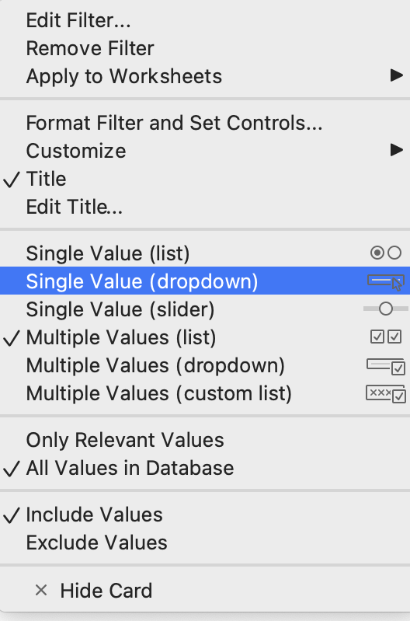
Marks and Filters
Show only data with a field preset to a specific value
Notes:
Filters show filters
sort
Toolttip
Keep only from the legend

Slide 31
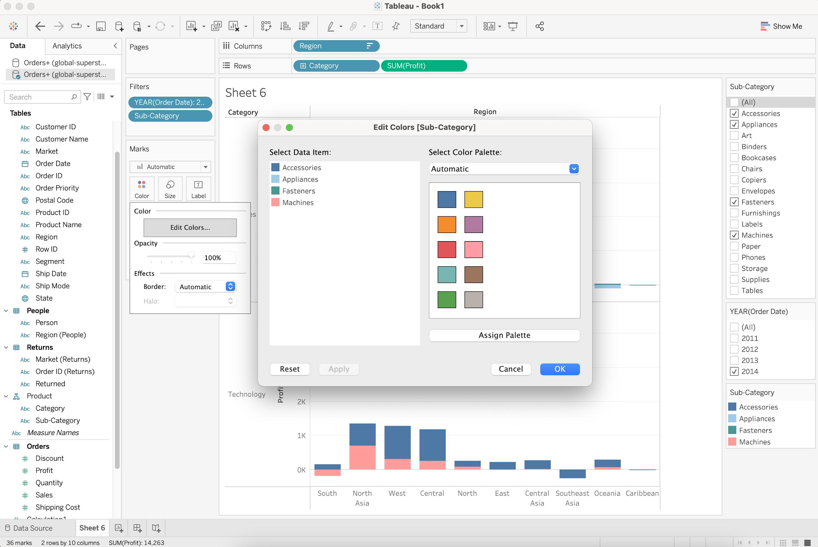
Markers
Adding details with markers
Color
Tooltip
show info by hover

Slide 32
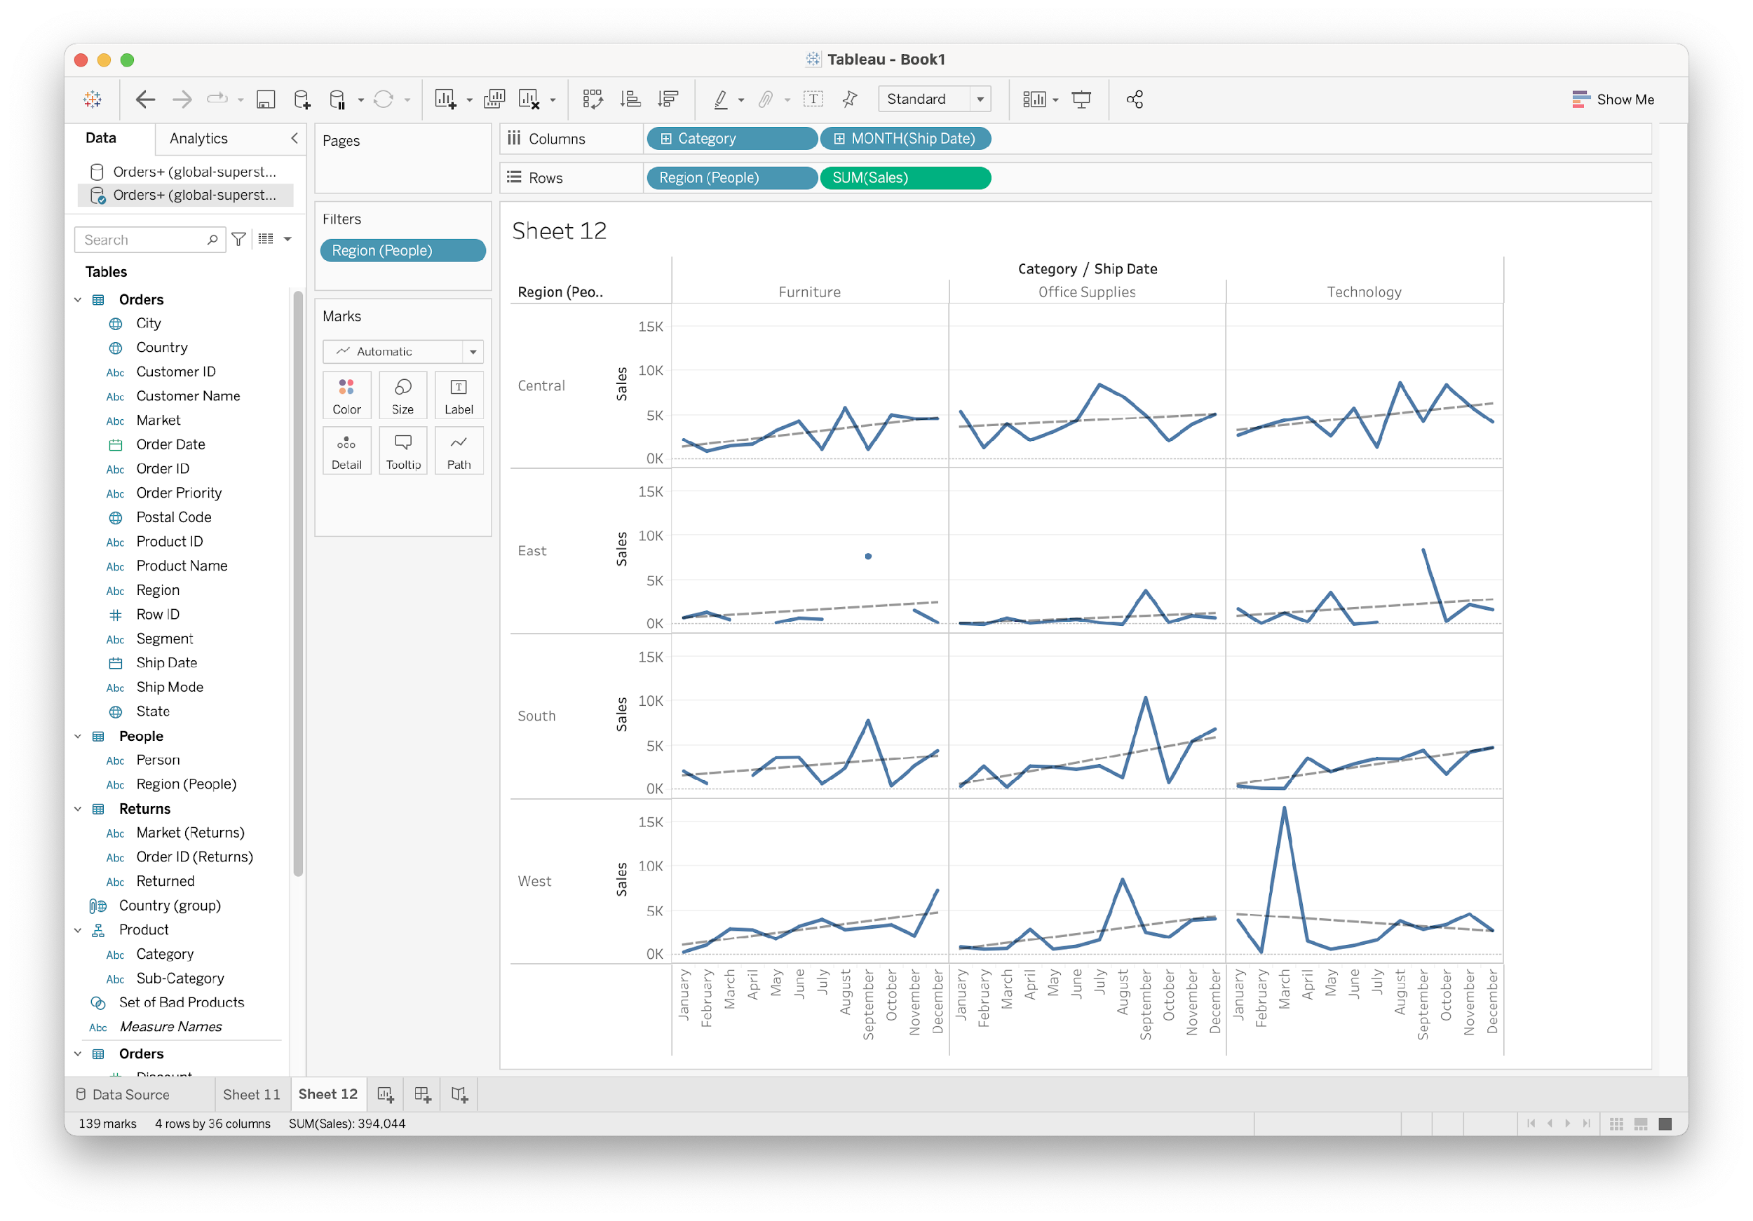
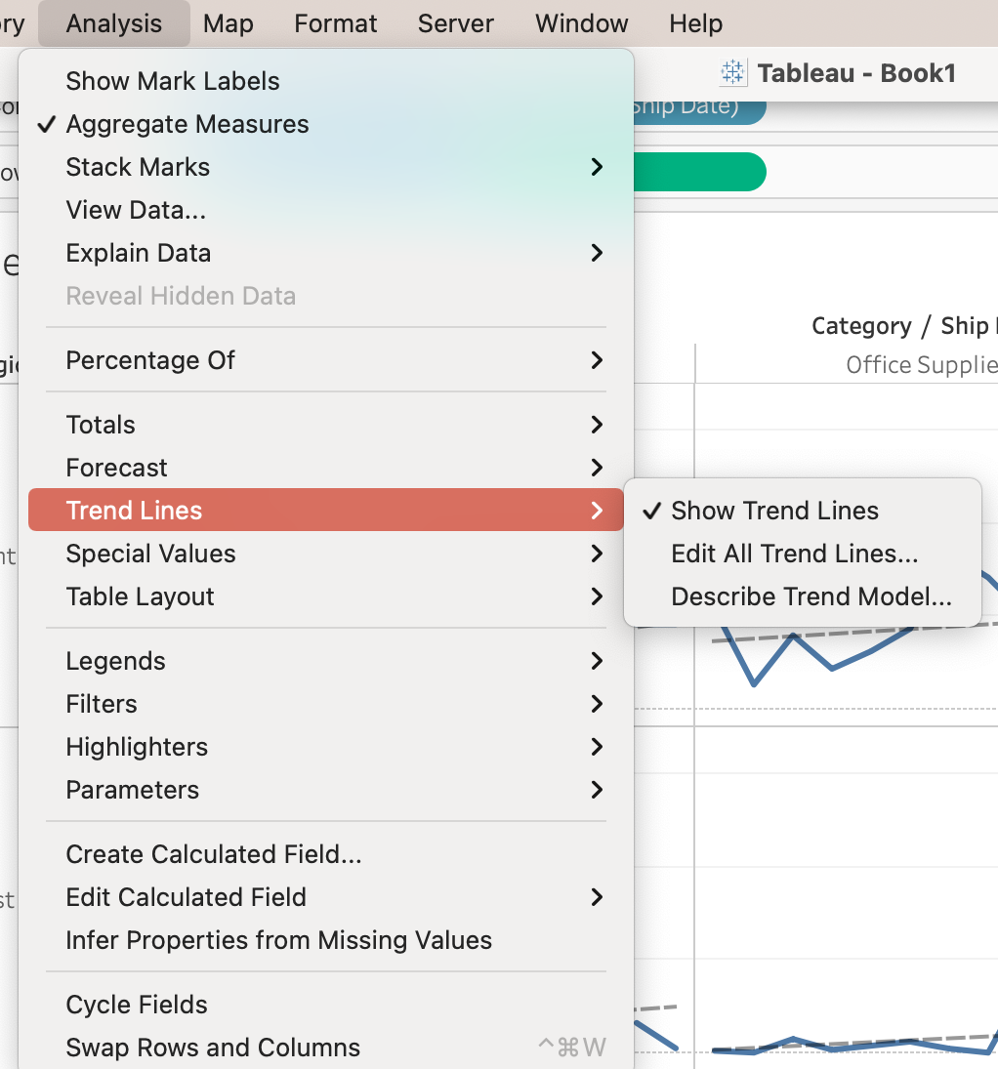
Trend Lines

Slide 33
Tableau Basics
Connecting to data
Show me
Combining data
multiples & dual axis
Worksheets
Groups and sets
Aggregations
Calculated fields
Hierarchies
Table calculation
Marks and filters
Summary

Slide 34
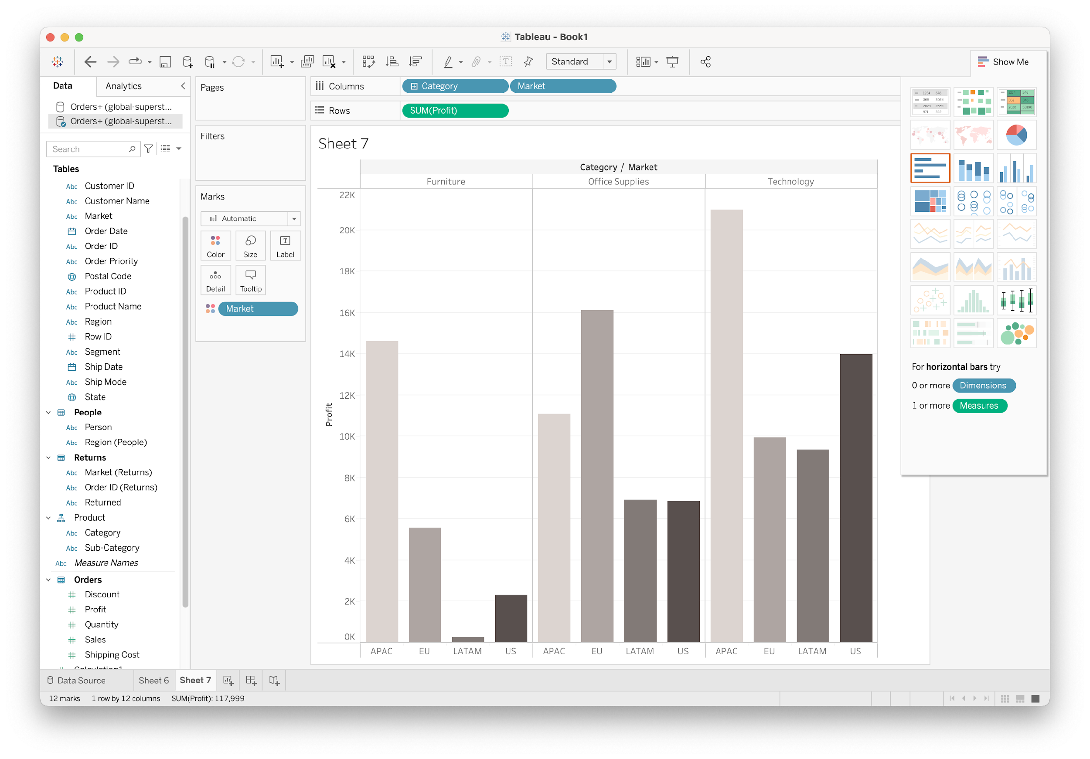
Show Me
Quick way to start with a visualization that you can later enhance

Slide 35
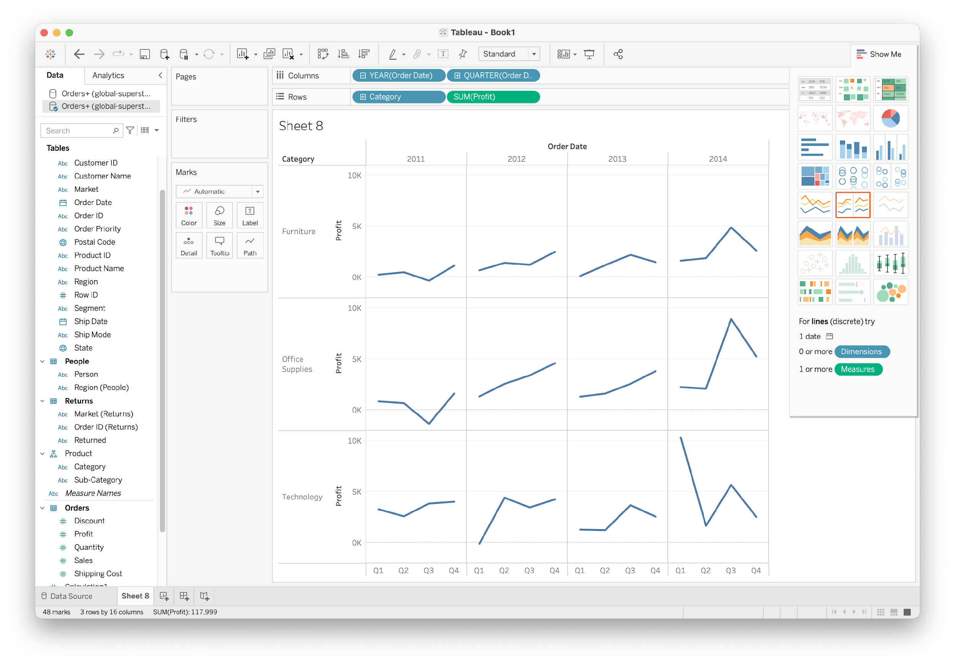
Small Multiples
Multiple fields as rows/columns

Slide 36
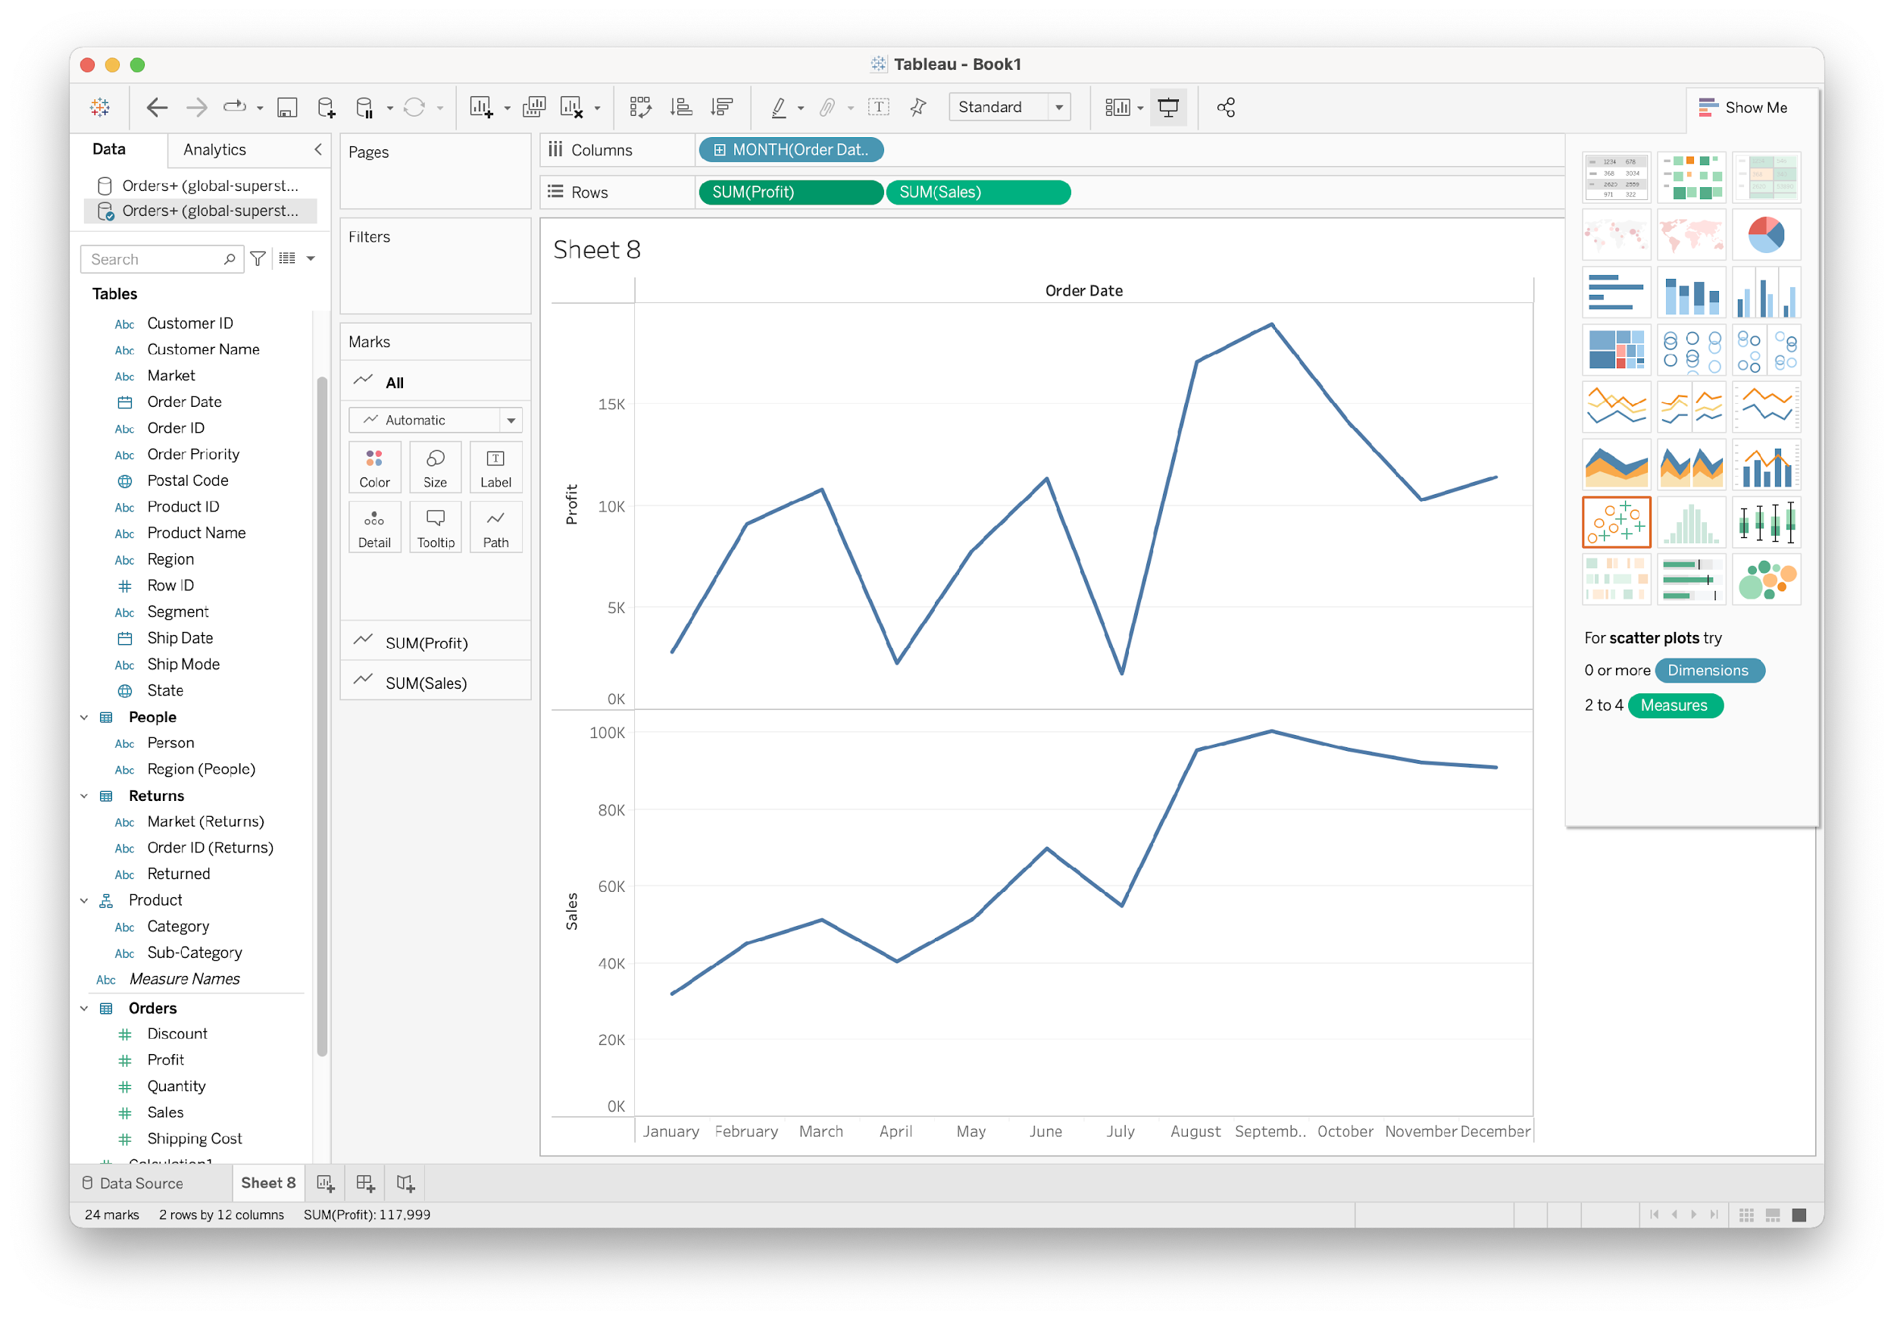
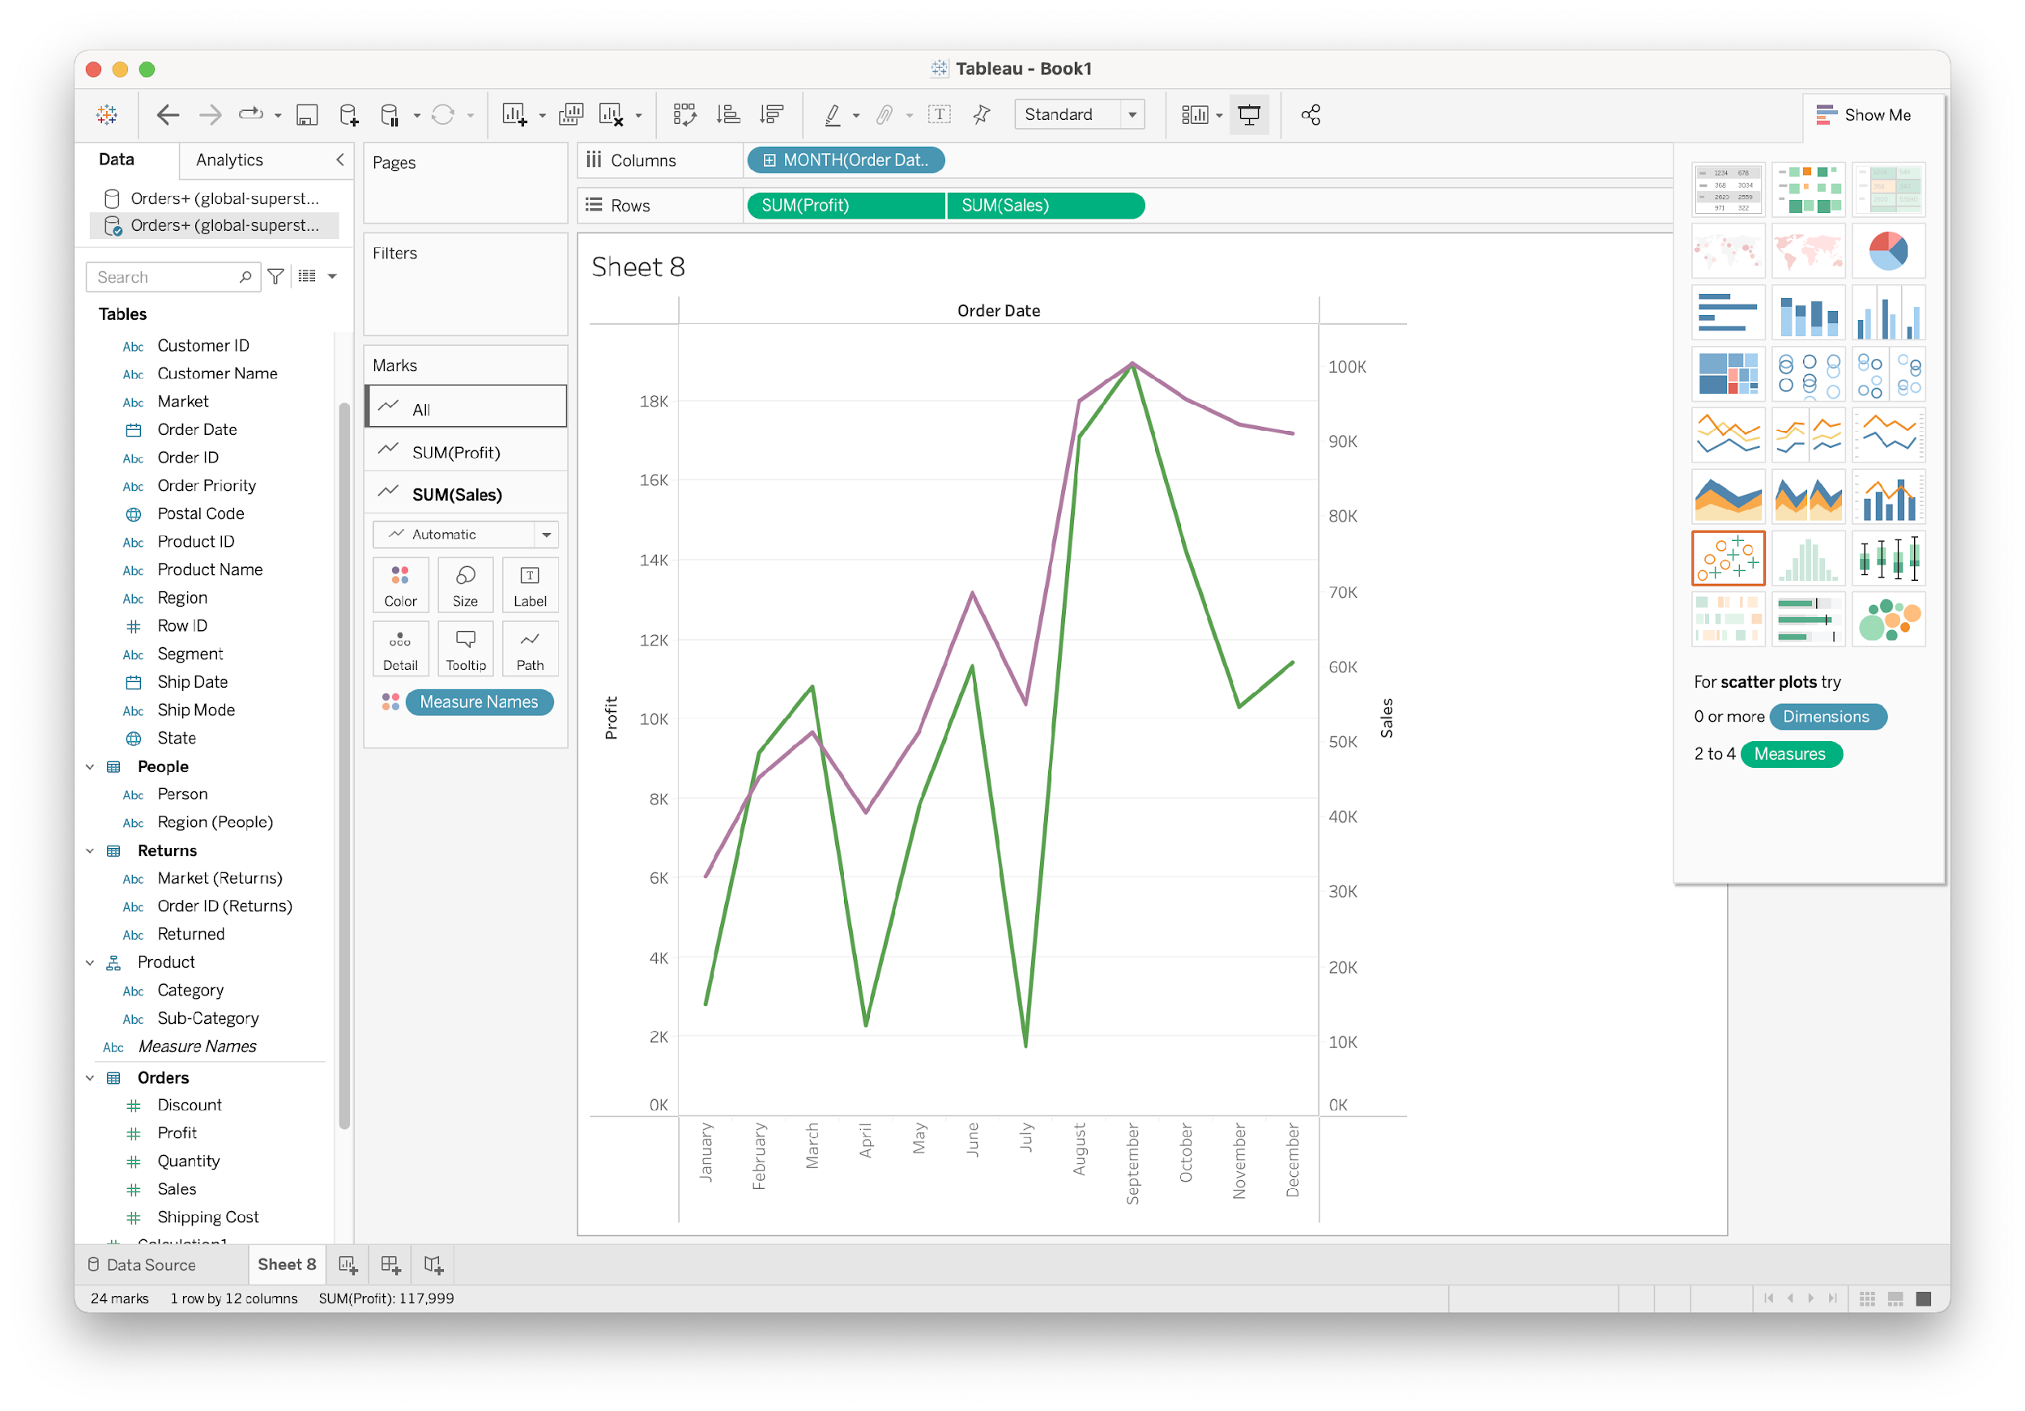
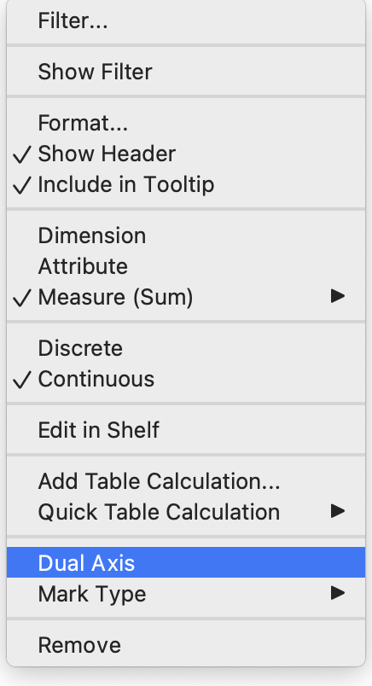
Dual Axis
Plotting multiple variable on one plot

Slide 37
Tableau Basics
Connecting to data
Show me
Combining data
multiples & dual axis
Worksheets
Groups and sets
Aggregations
Calculated fields
Hierarchies
Table calculation
Marks and filters
Summary

Slide 38
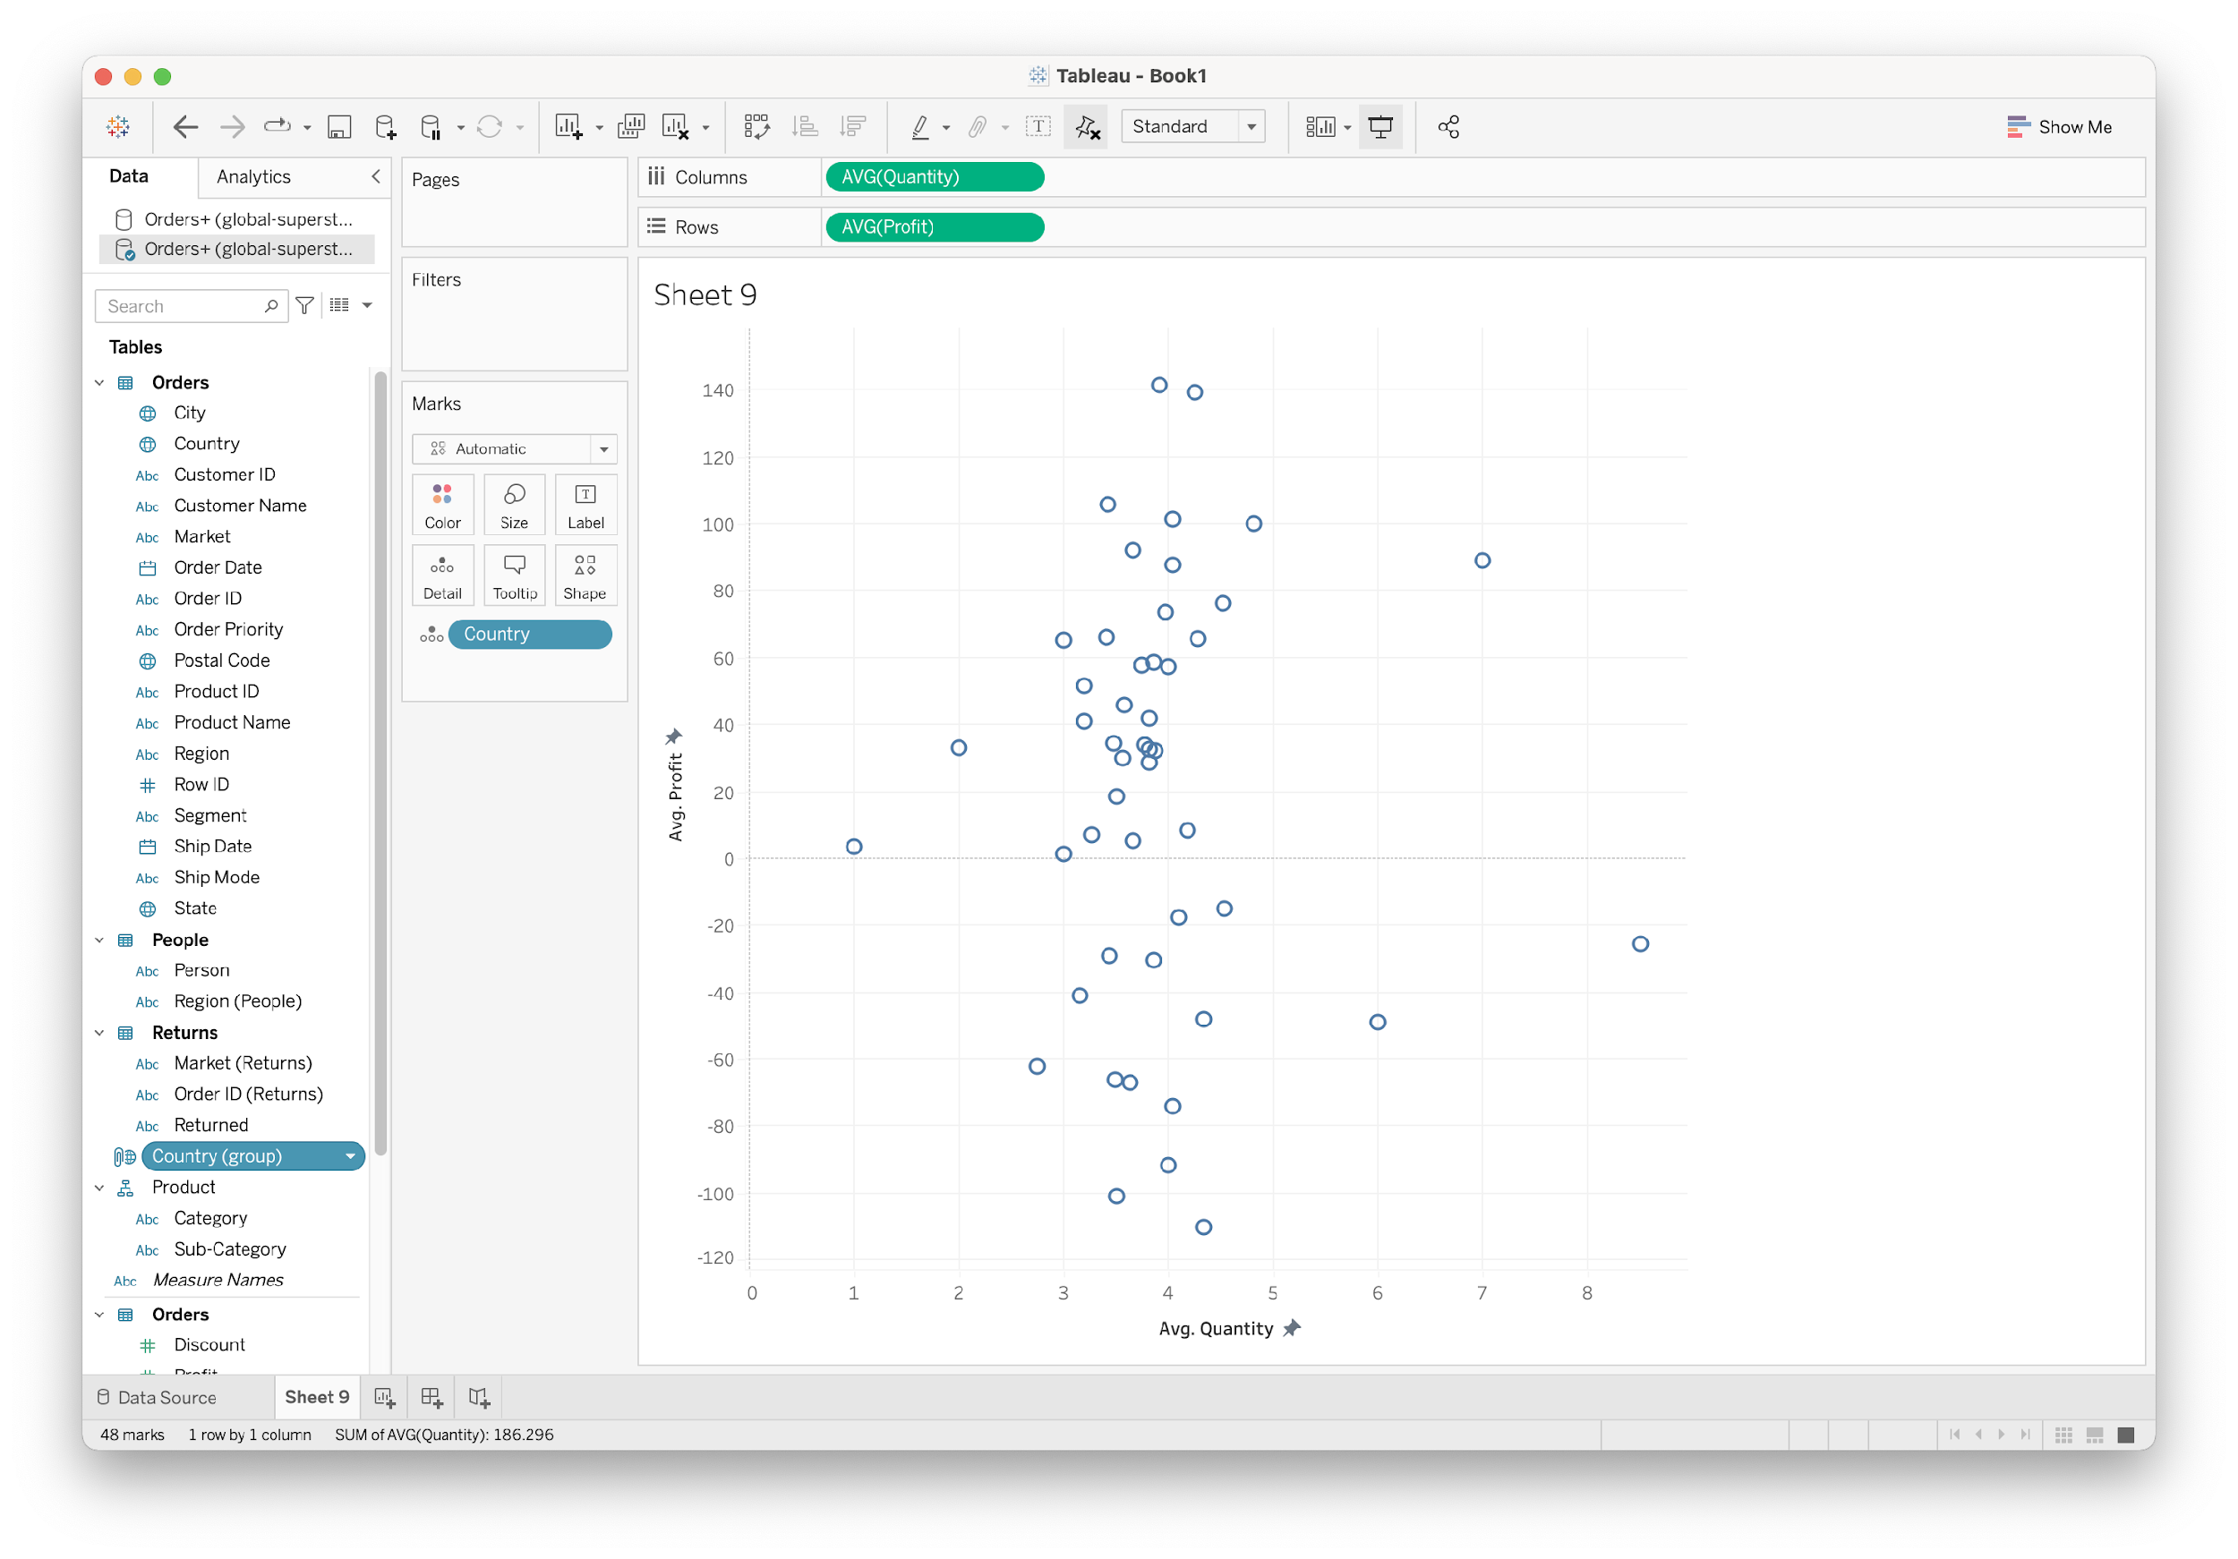
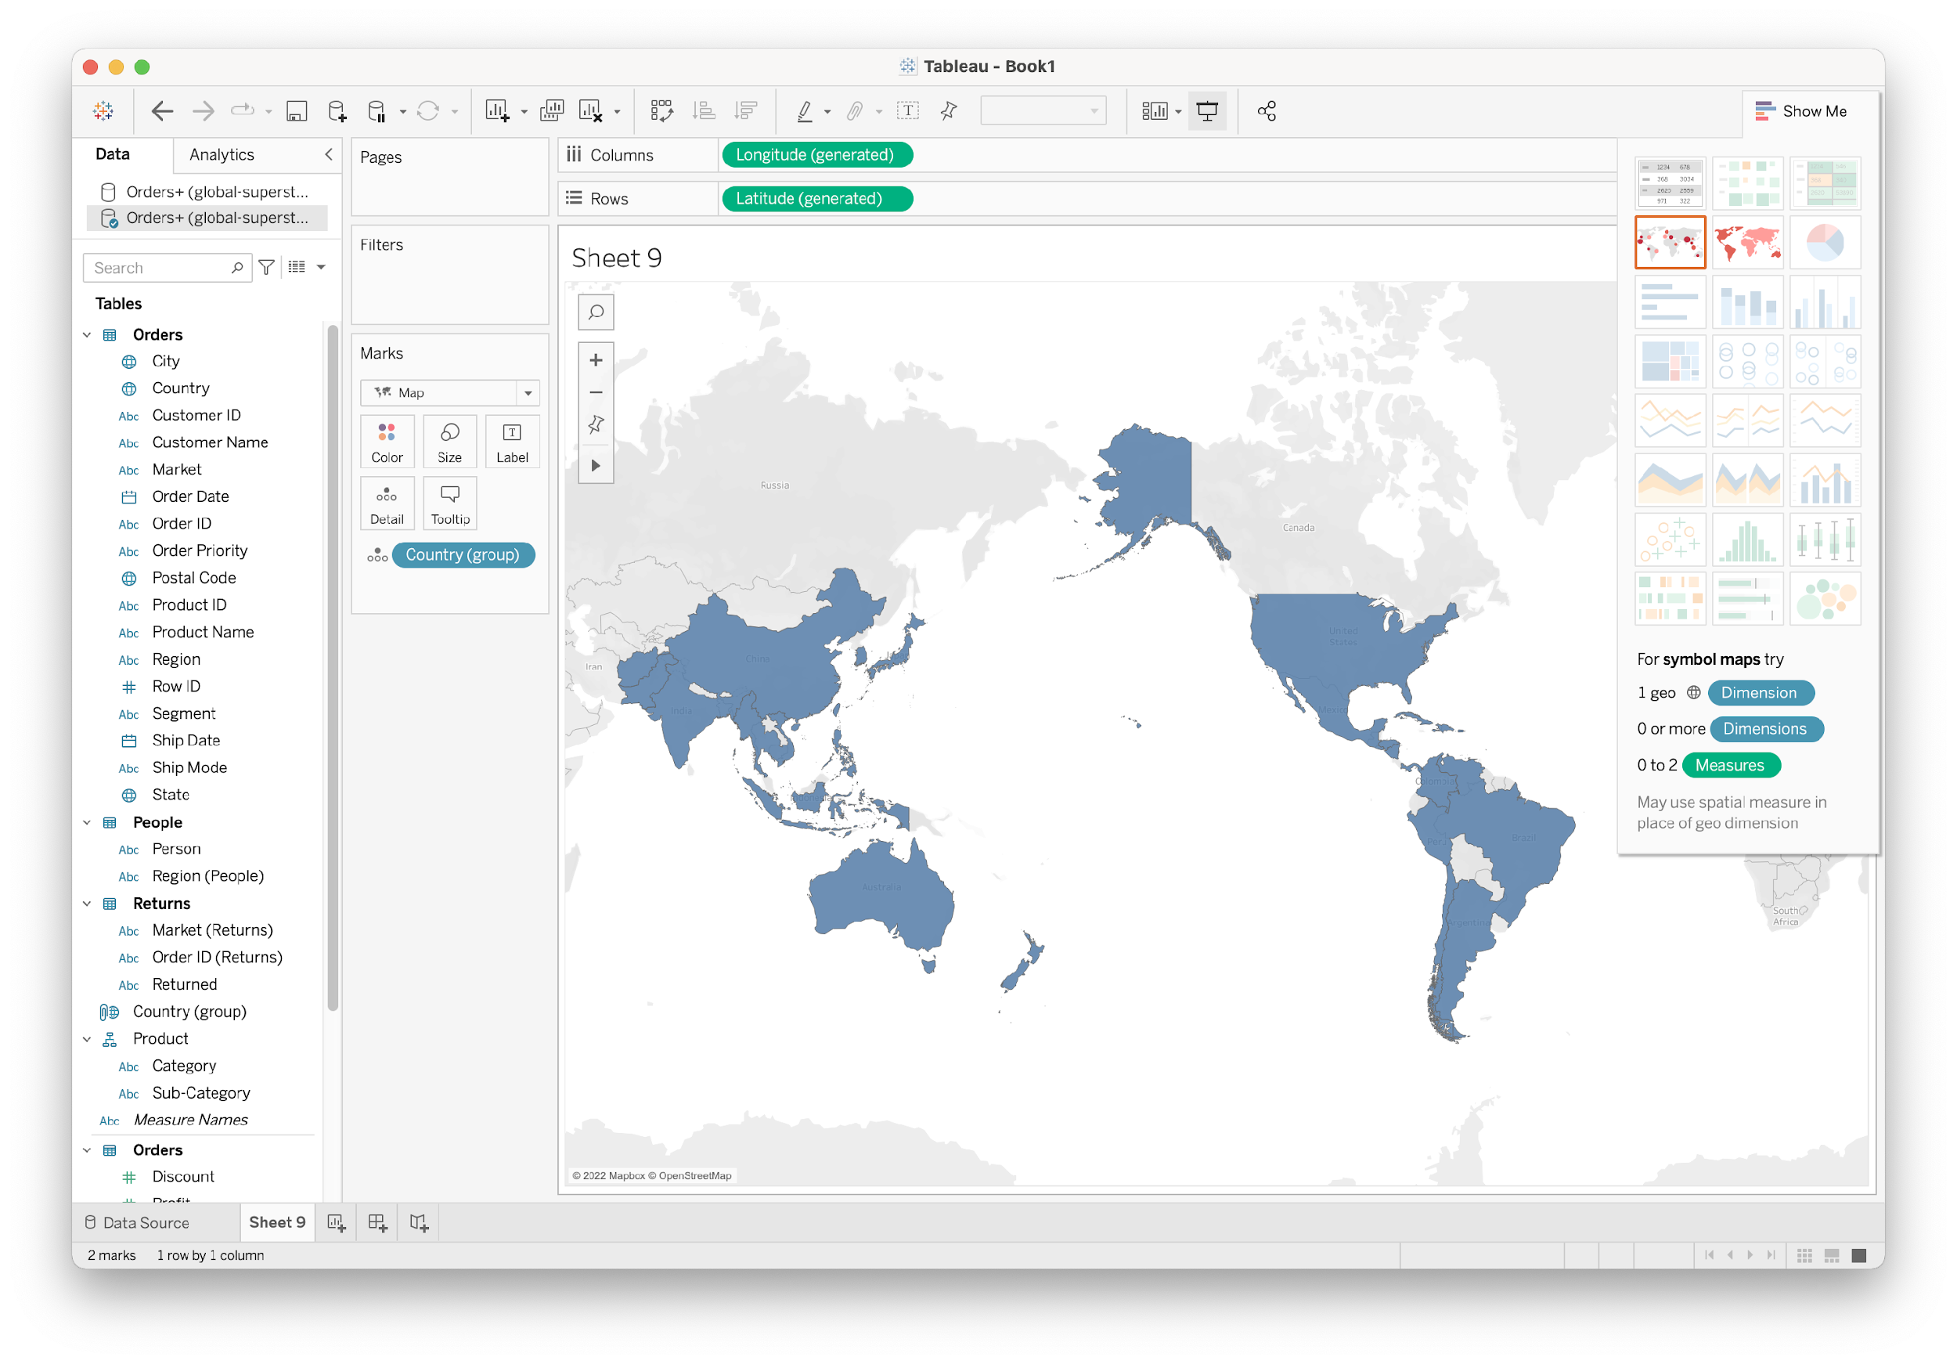
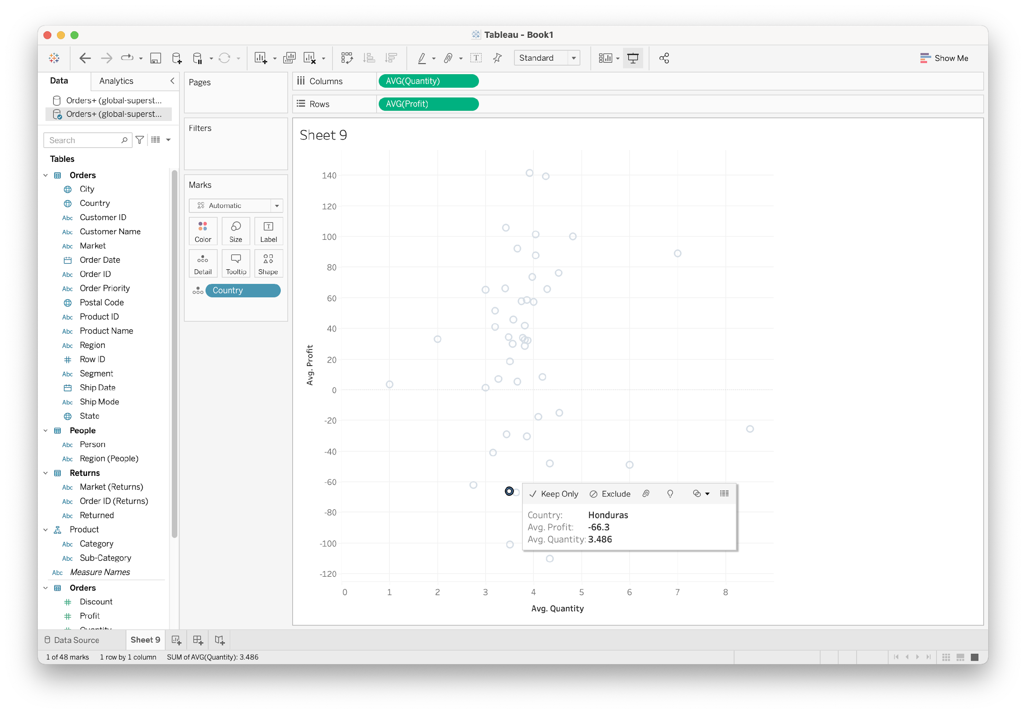
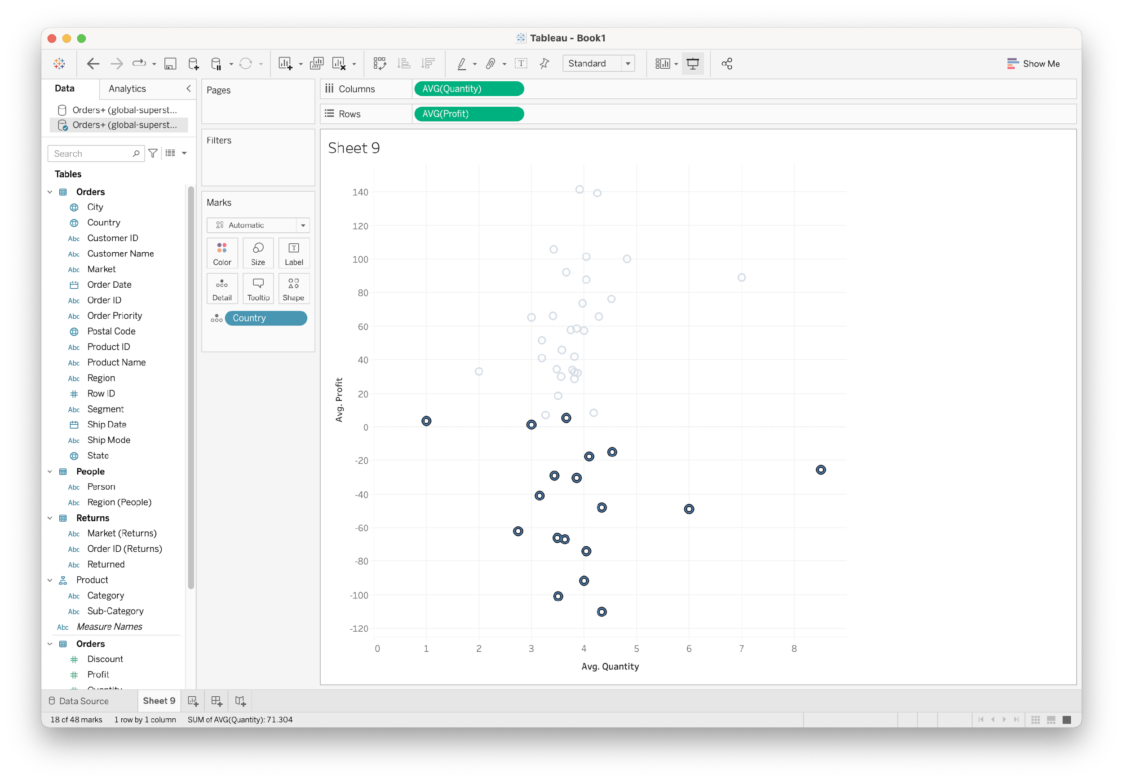
Groups
Illuminate message
Static members

Slide 39
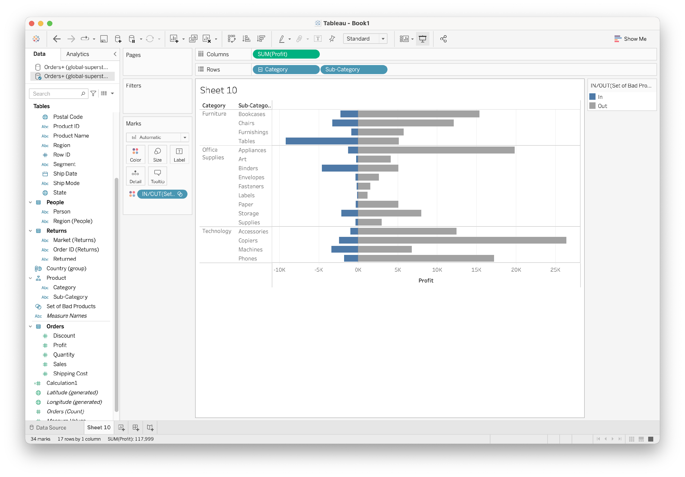
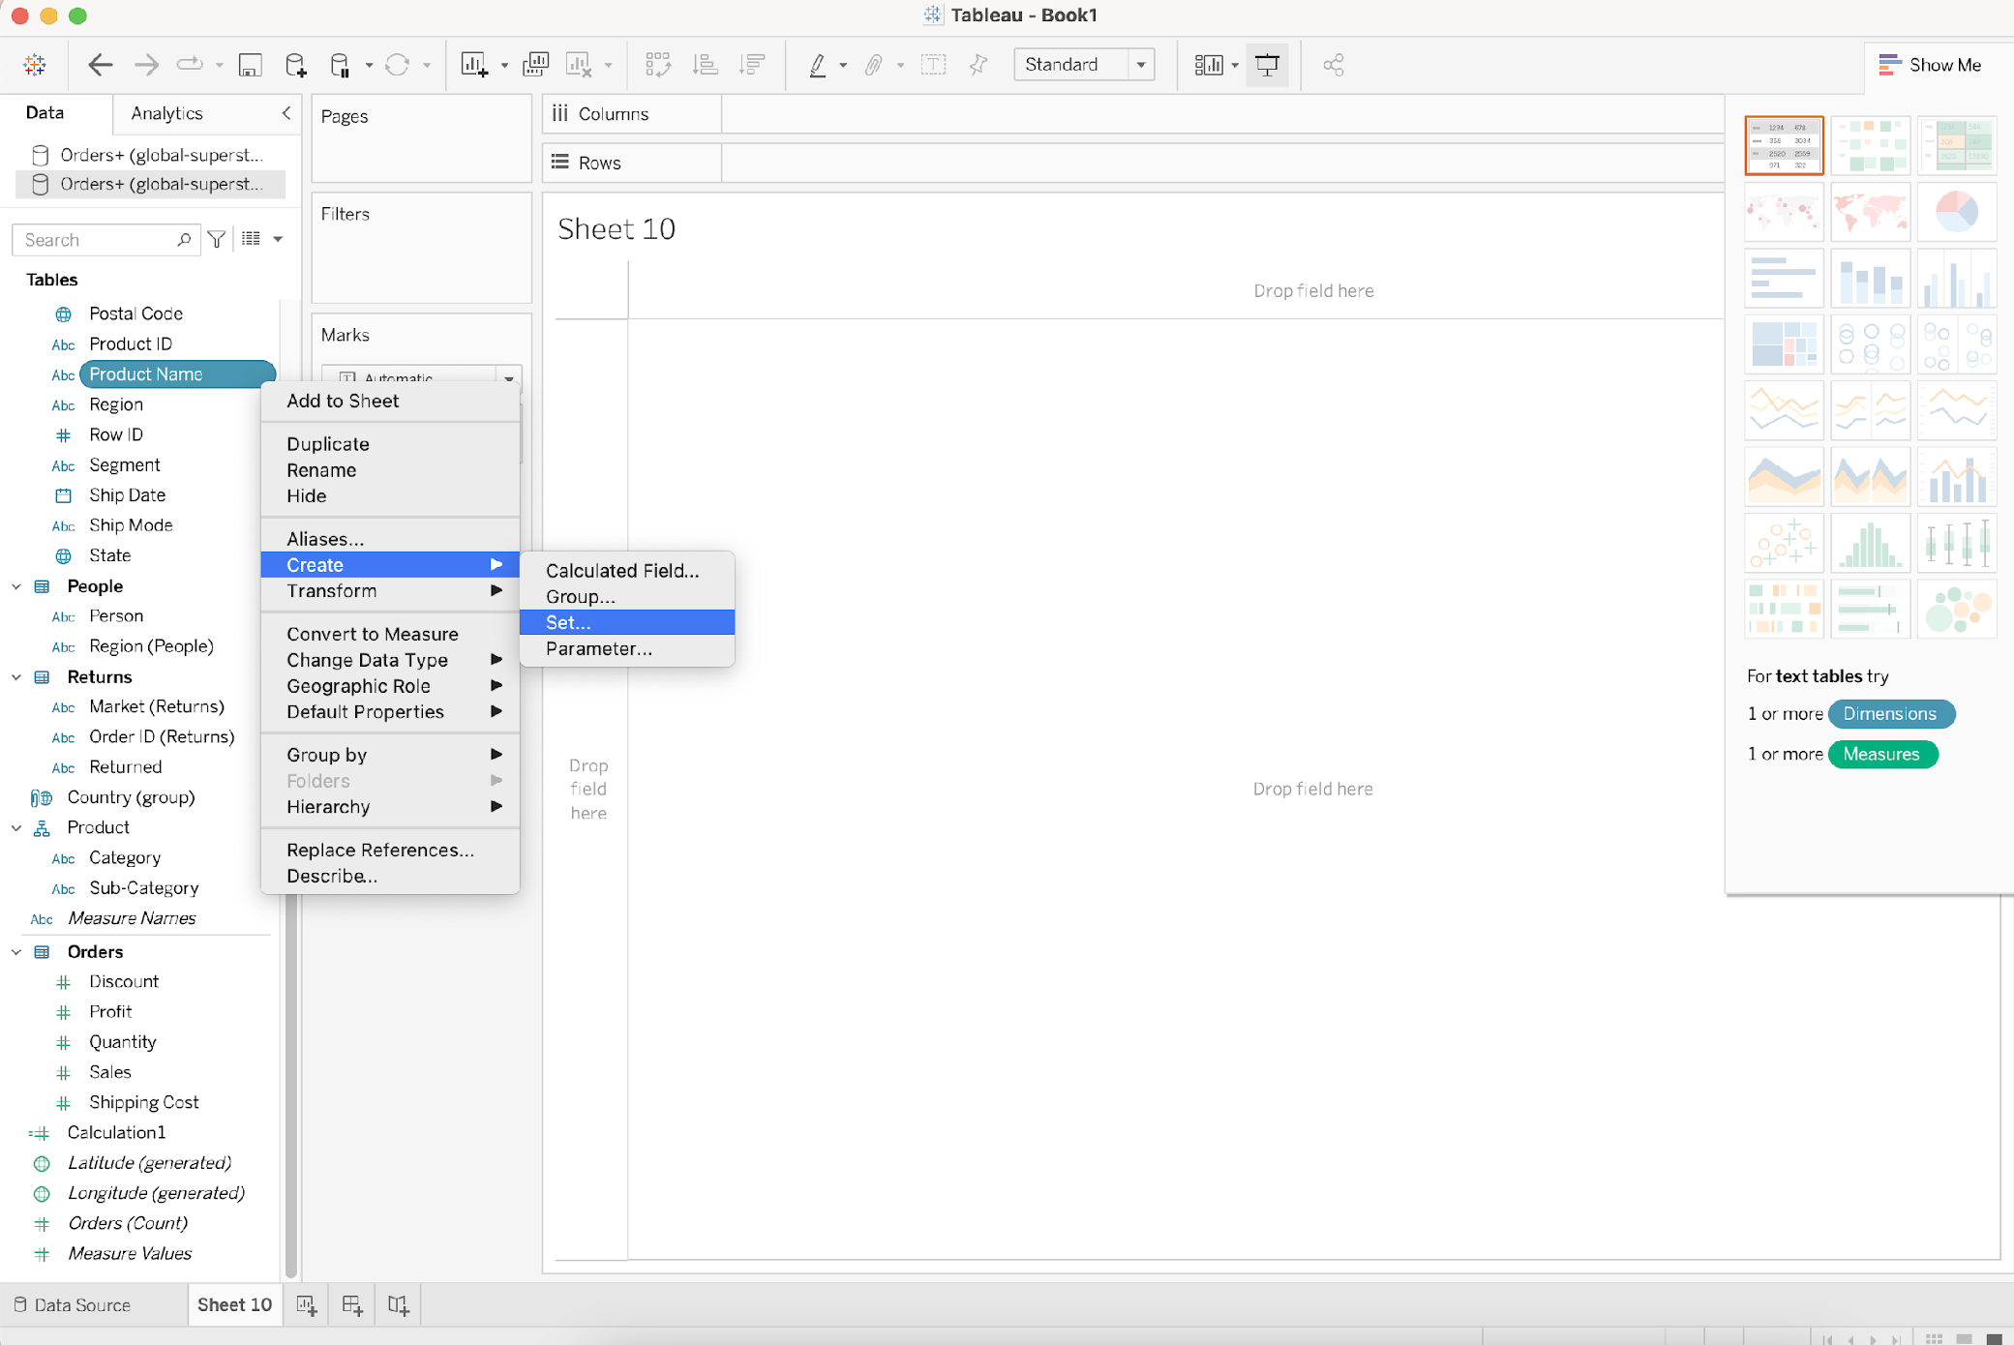
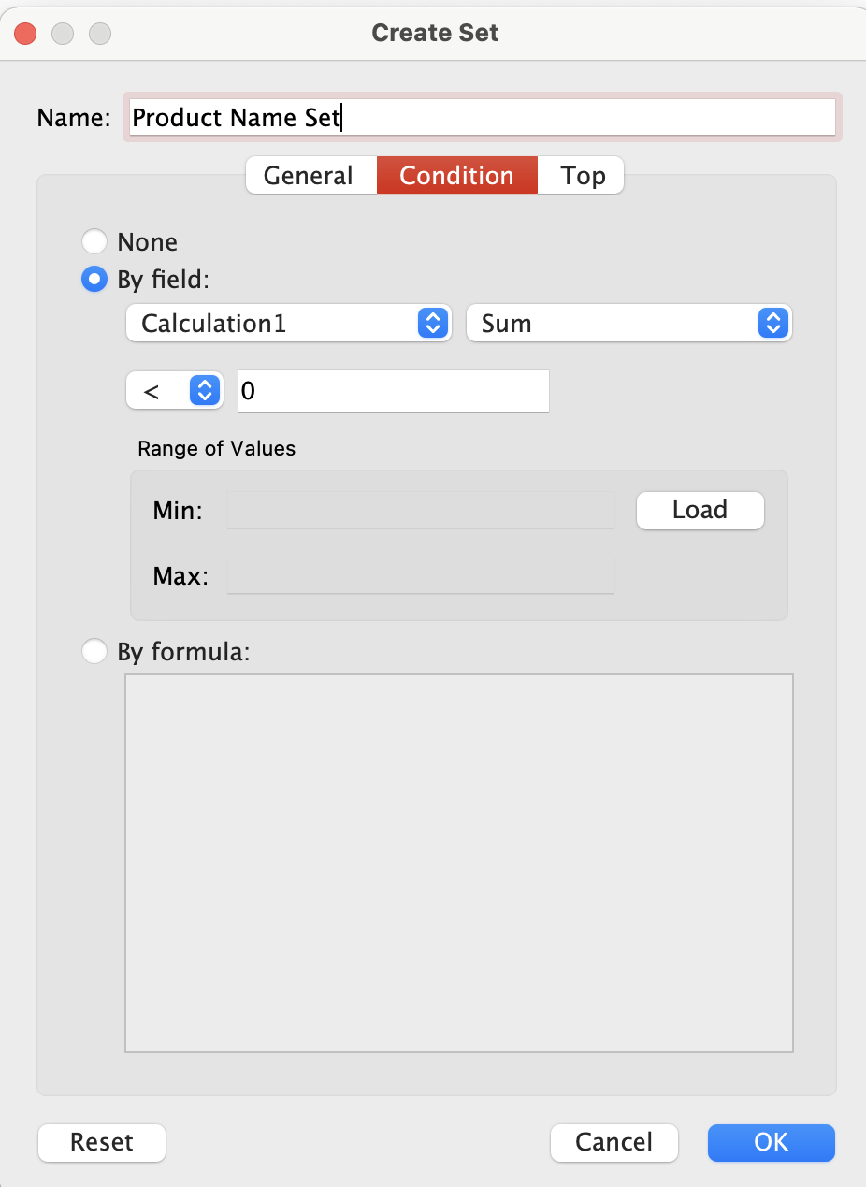
Sets
Similar to groups
Dynamic members
Can change when the underlying data changes

Slide 40
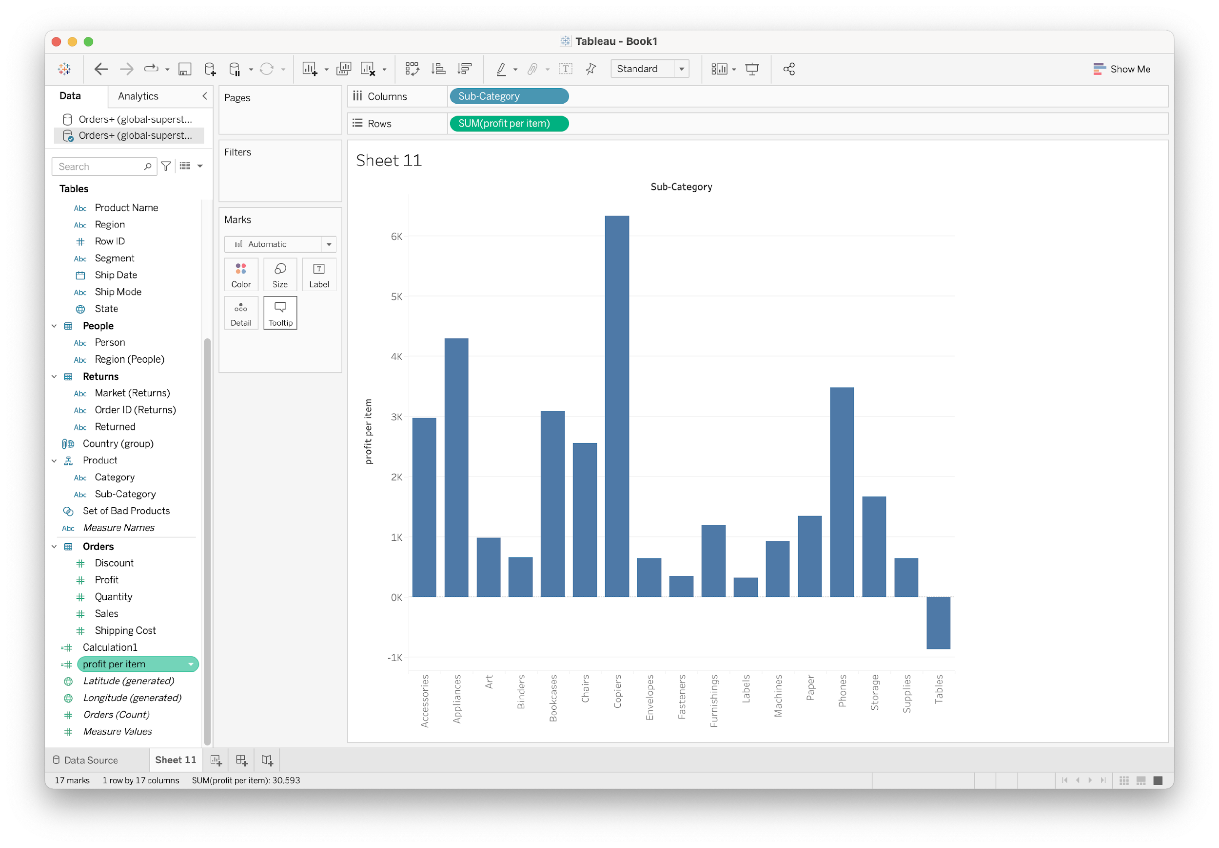
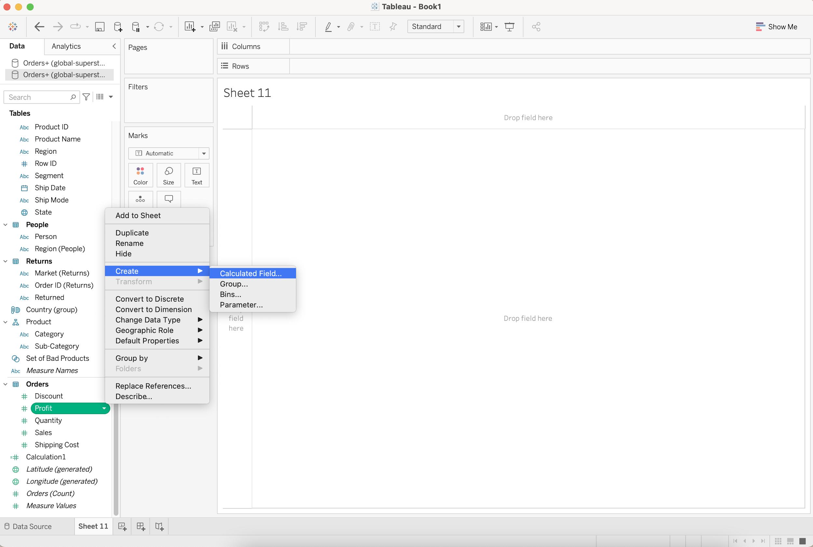
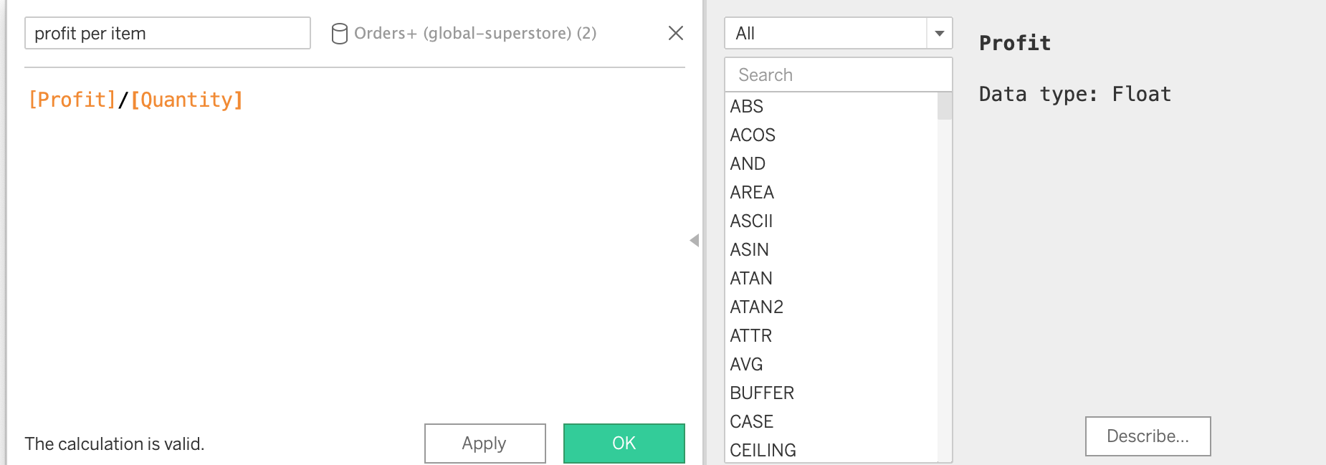
Calculated Fields
Creating new fields from underlying data

Slide 41
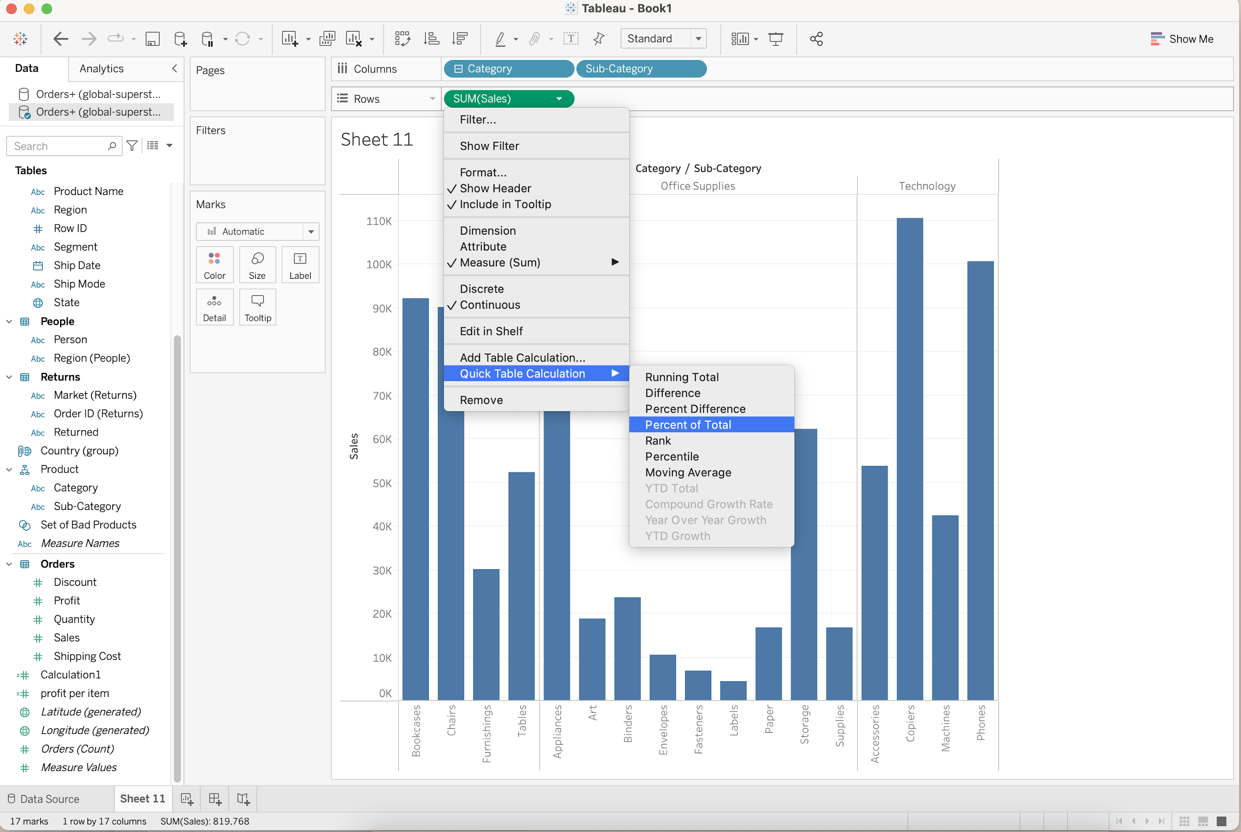
Table Calculations
Compare and analyze existing data

Slide 42
Tableau Basics
Connecting to data
Show me
Combining data
multiples & dual axis
Worksheets
Groups and sets
Aggregations
Calculated fields
Hierarchies
Table calculation
Marks and filters
Summary

Slide 43
Part 2: Explore and Share
Create dashboard and stories to collect your plot into interactive visualizations

Slide 44





Where to start?
Question
Start with a questions
Intuition
Just look & play & drag and drop
Look
Don’t forget !! Take a look at the data
Clean up the data ( data interpreter)
Explore
start small
step by step

Slide 45
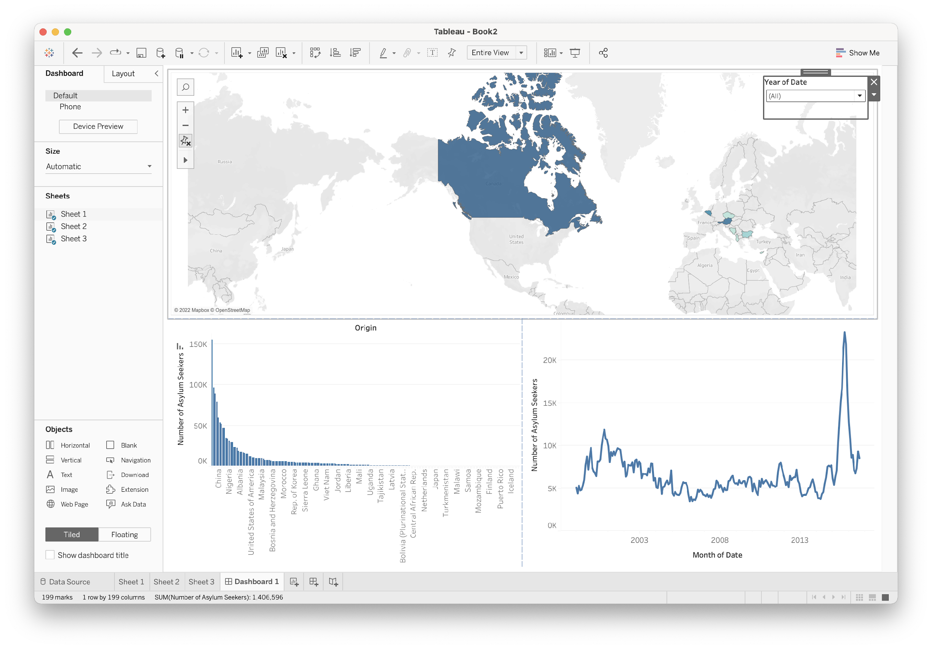
Dashboard
A number of visualizations
Provide better insight
Interactive

Slide 46
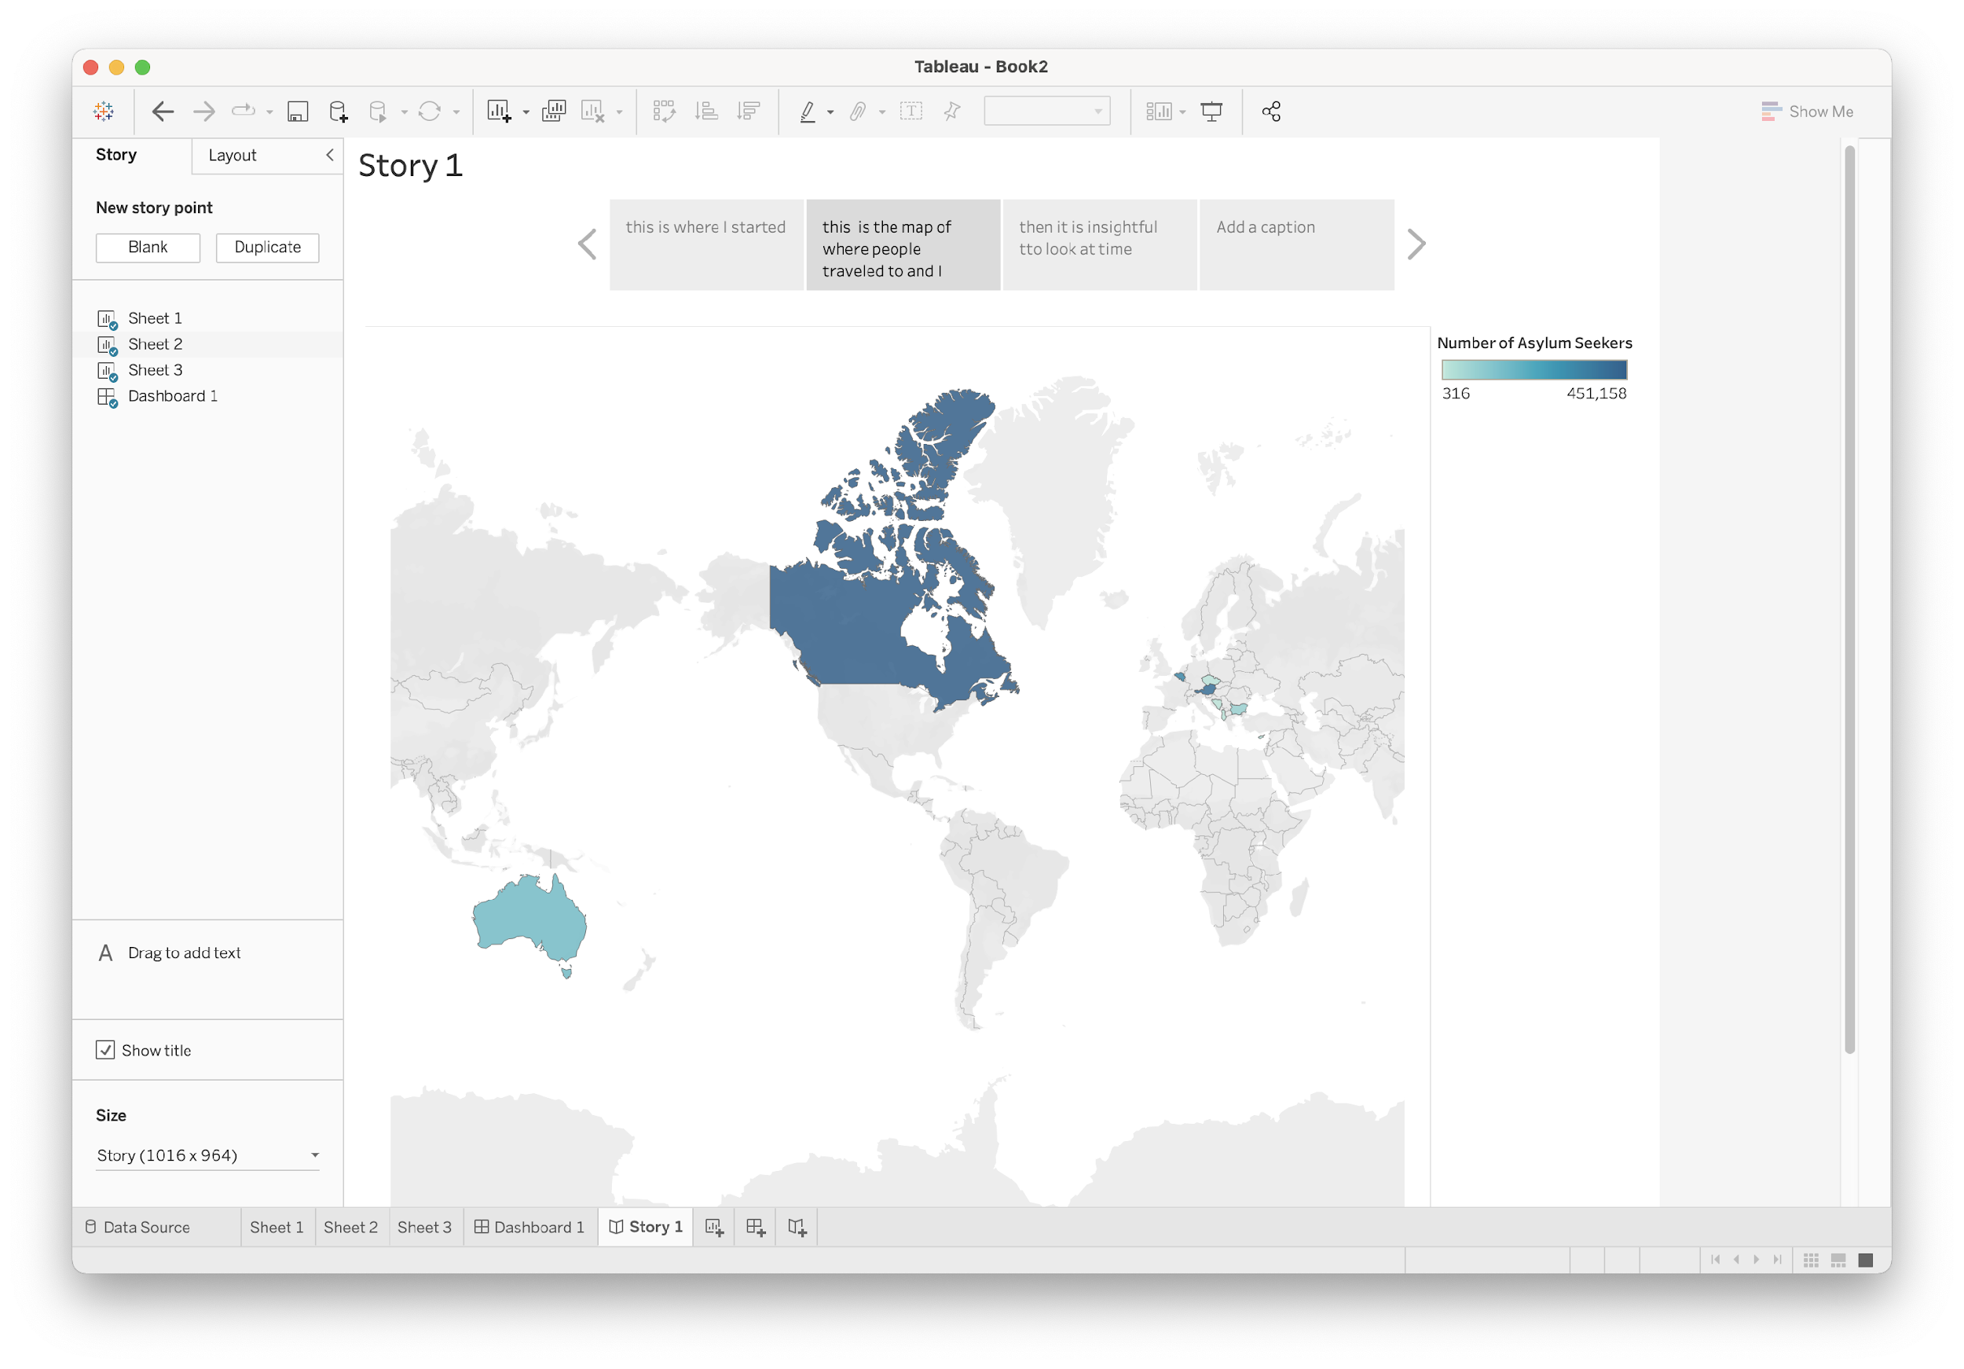
Story
Narrative on how you arrived at a particular insight
Sequence
Comic book
History & context

Slide 47
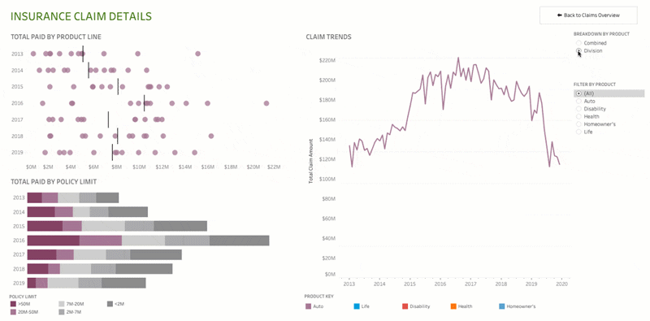
Animations

Slide 48
Summary
Data Visualization
Basic Tableau
Explore and Communicate
Explain

Slide 49

Questions? Thank You!

